Slide 1
Tutorial Machine Learning in Solid Mechanics
Task 2&3: Hyperelasticity
Fabian Roth

Slide 2
Tutorial Machine Learning in Solid Mechanics
Sections
2.1
Data preparation
3.1
Data preparation
2.2
Naive model
3.2
Invariant-based model
2.3
Physics-augmented model
3.3
Deformation-gradient based model
2.4
Concentric sampled deformation gradients
3.4
Data augmentation

Slide 3
Task 2
Hyperelasticity I

Slide 4
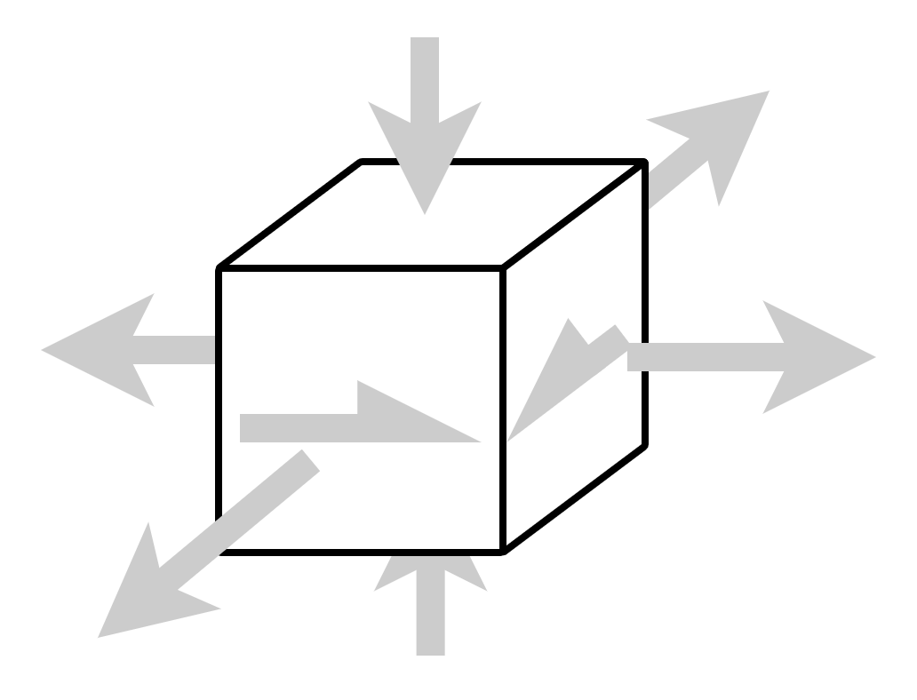
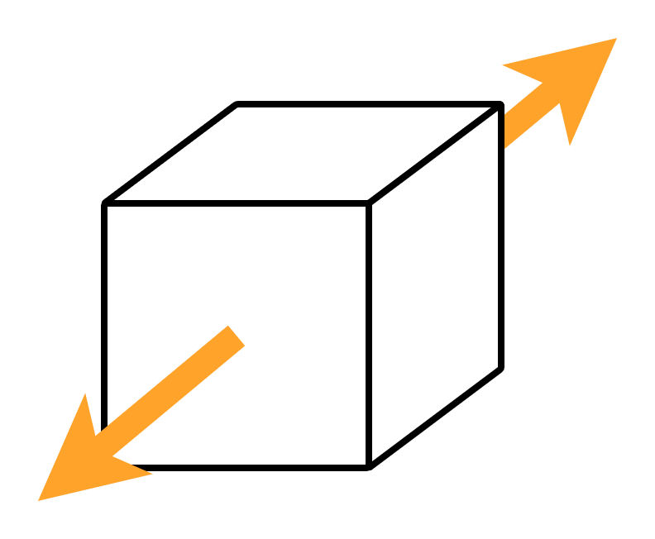
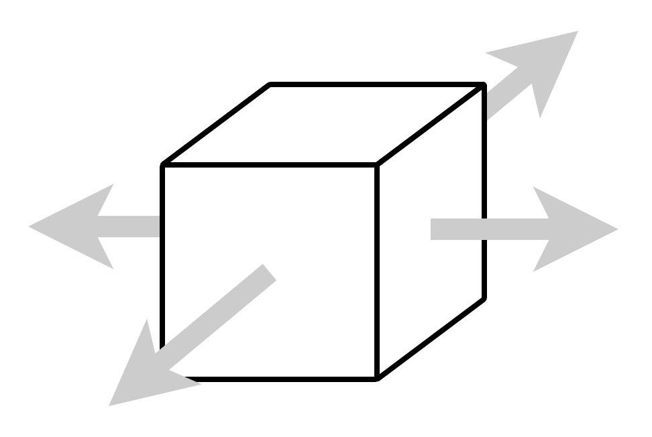
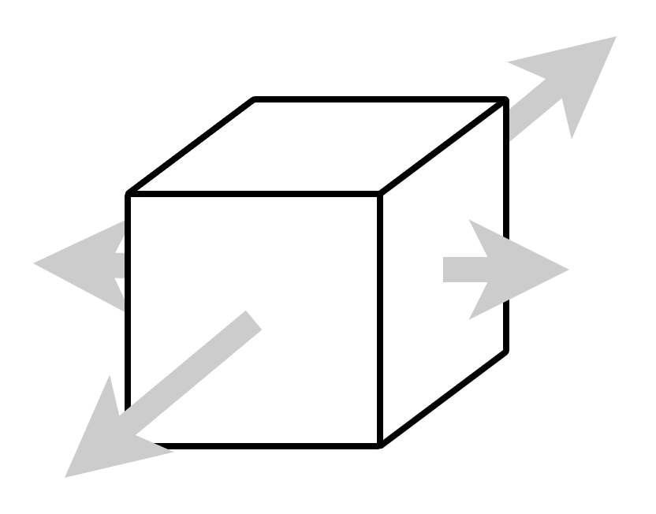
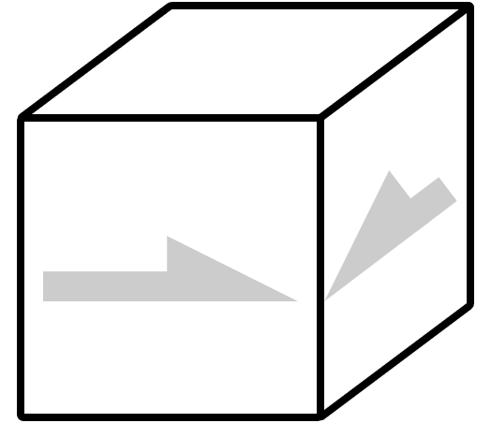
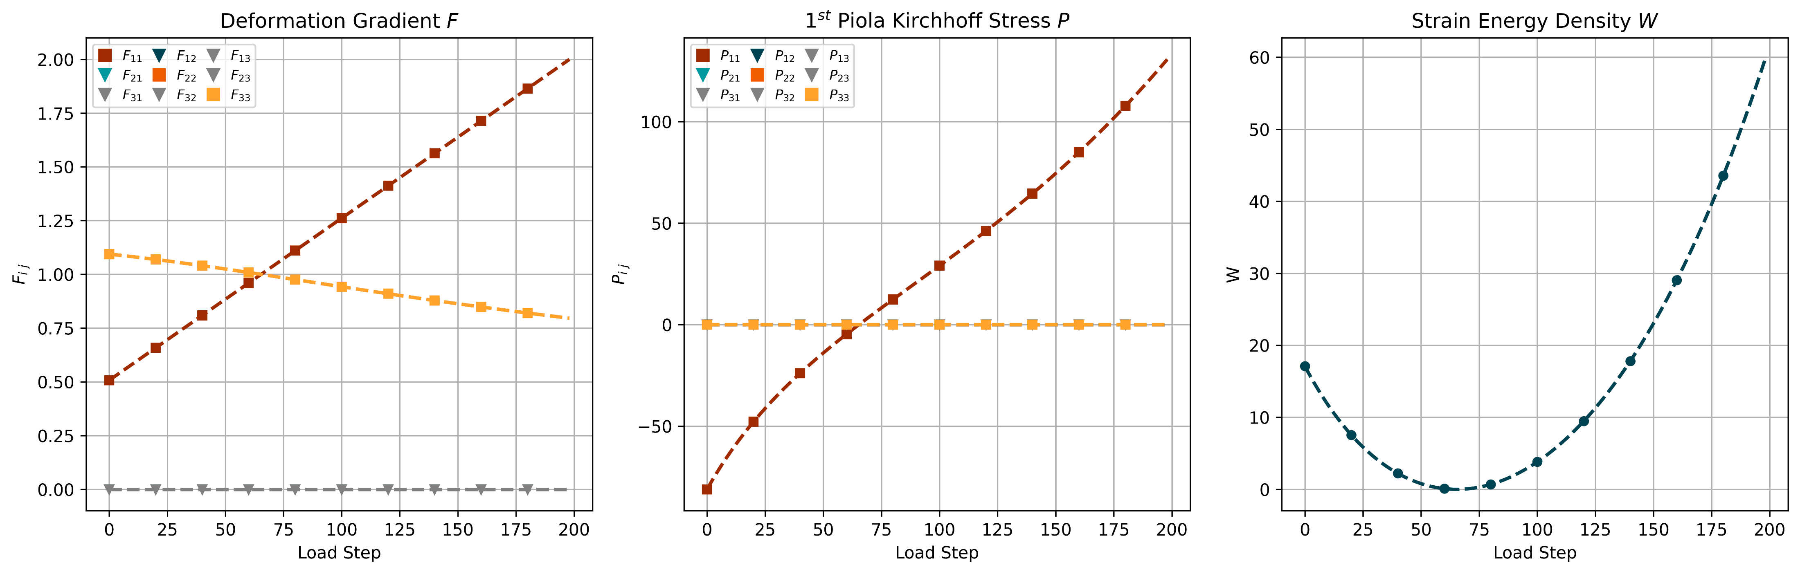
2 - 1.1
Data - Uniaxial

Slide 5
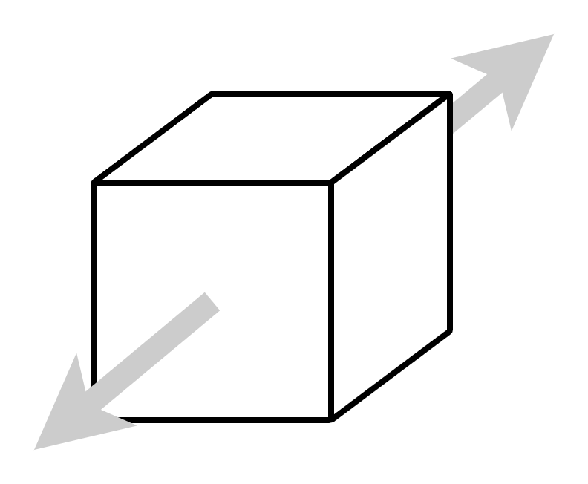
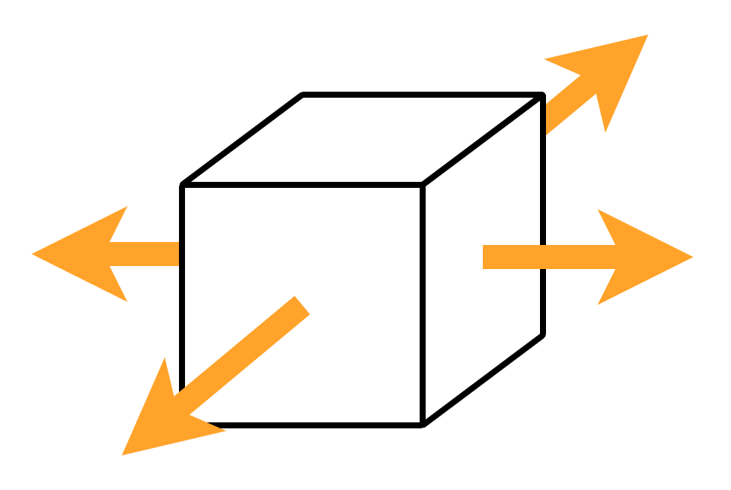
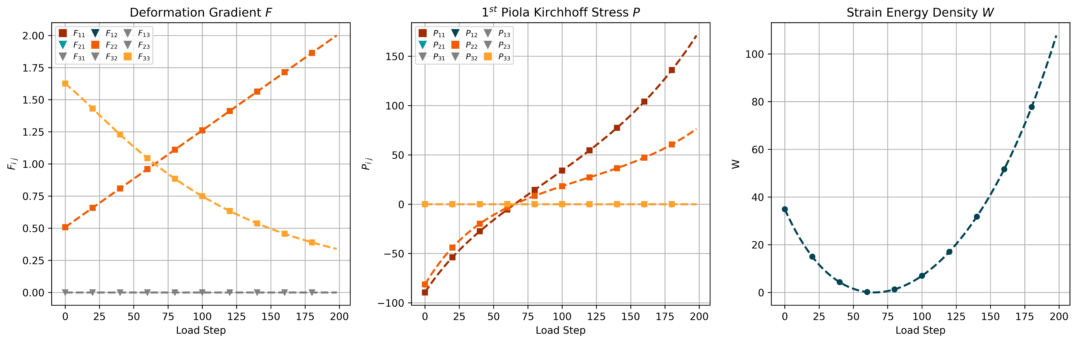
2 - 1.1
Data - Biaxial

Slide 6
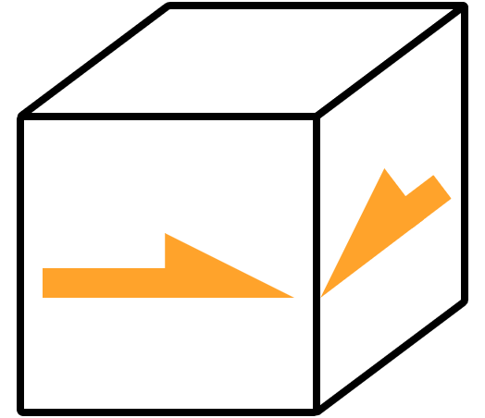
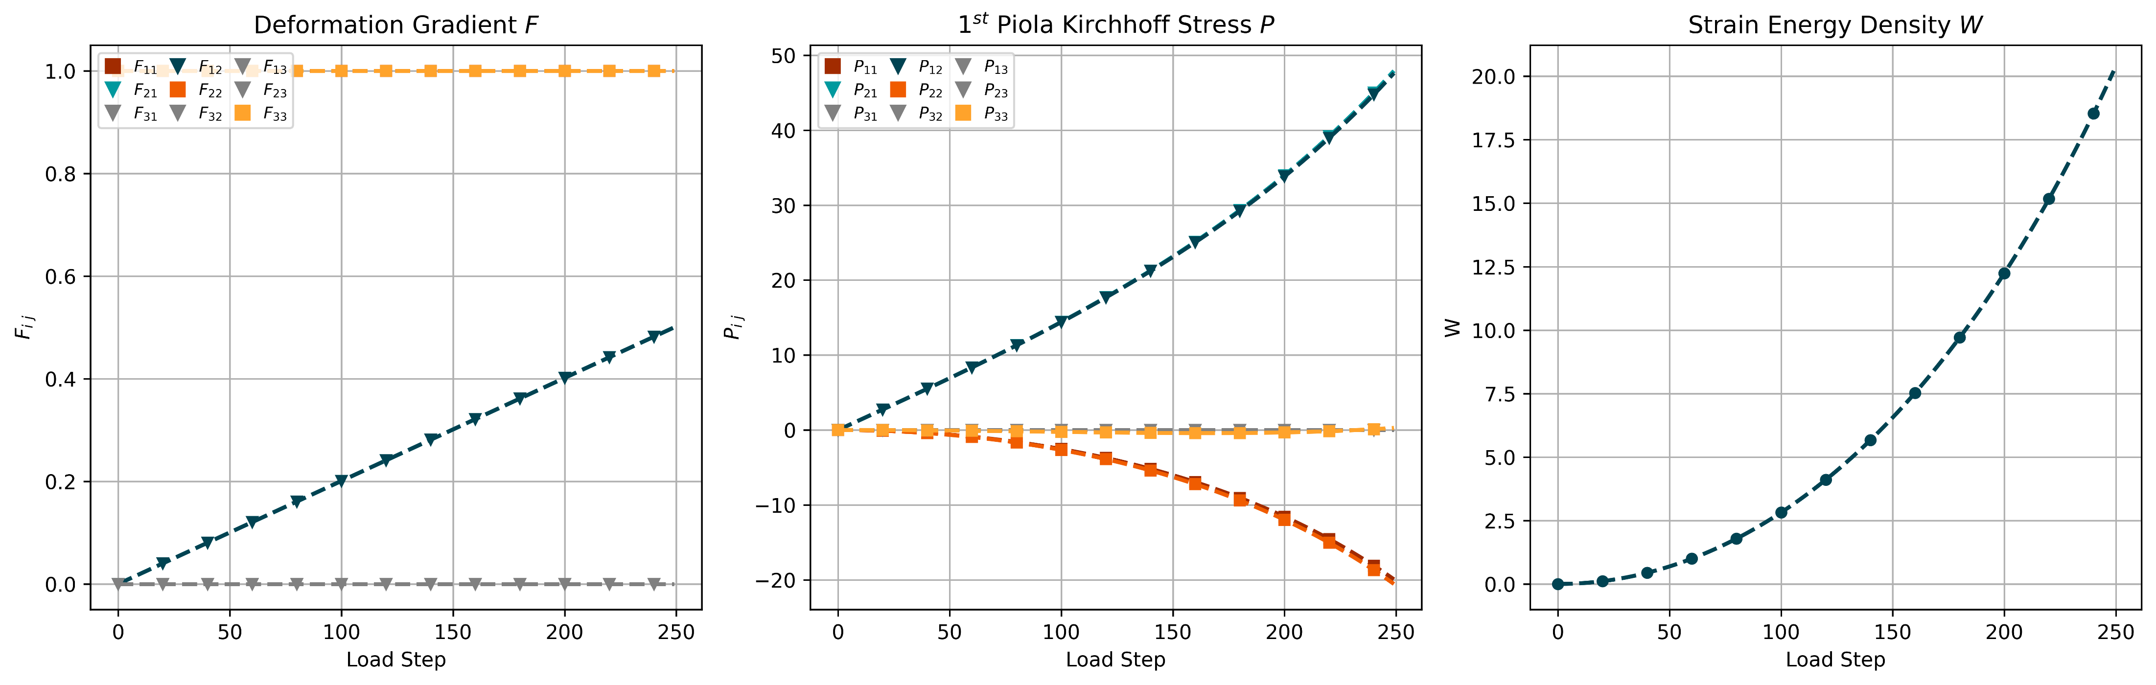
2 - 1.1
Data - Shear

Slide 7
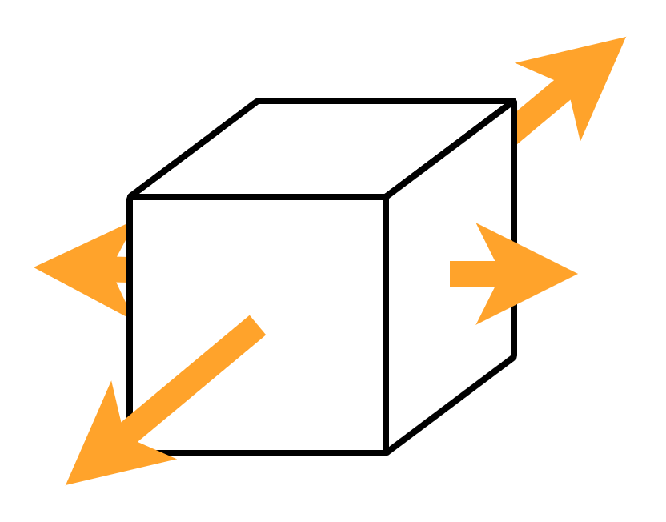
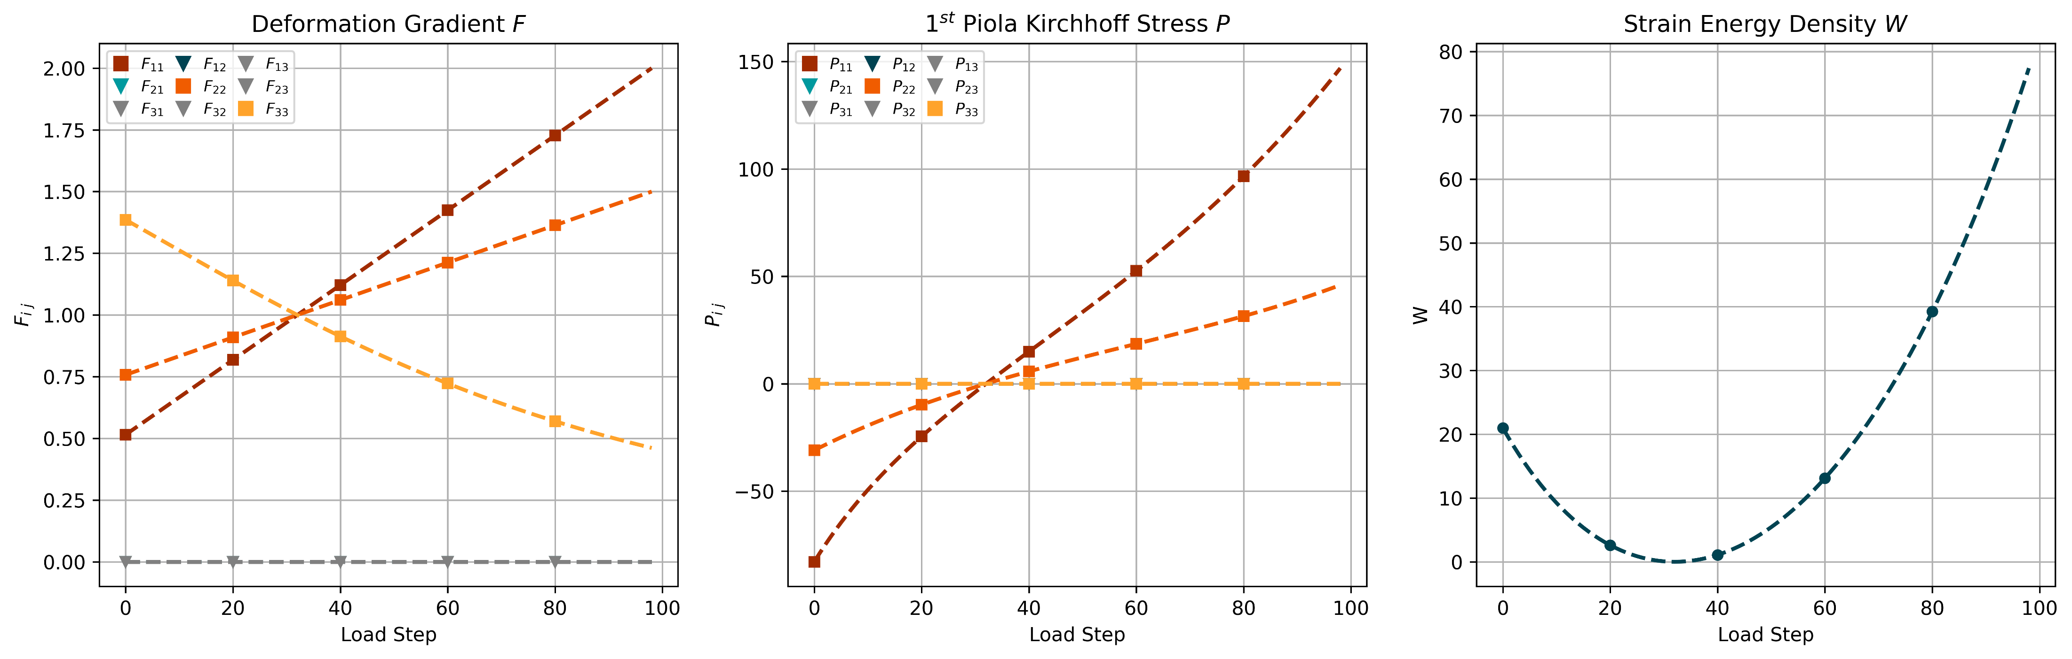
2 - 1.1
Data - Biaxial Test

Slide 8
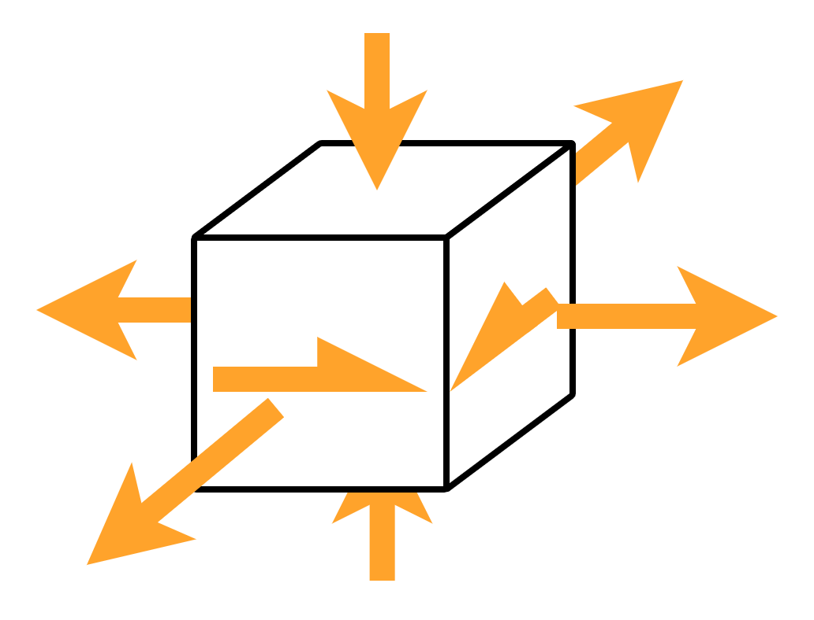
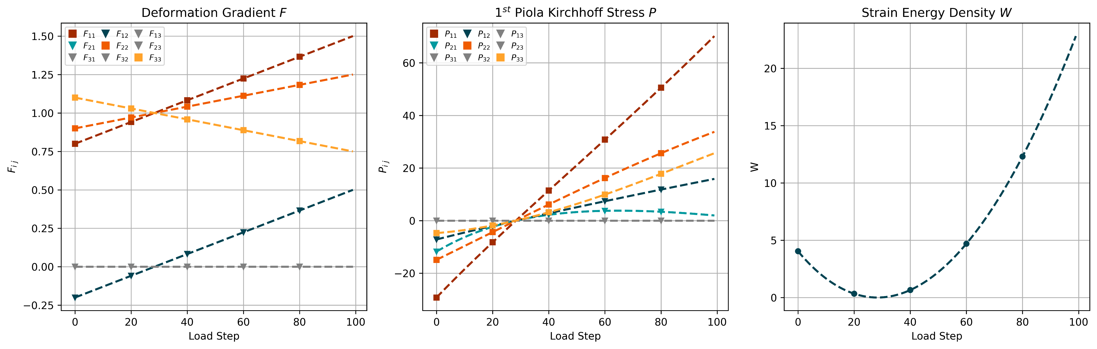
2 - 1.1
Data - Mixed Test
Notes:
Talk about interpolation/extrapolation

Slide 9
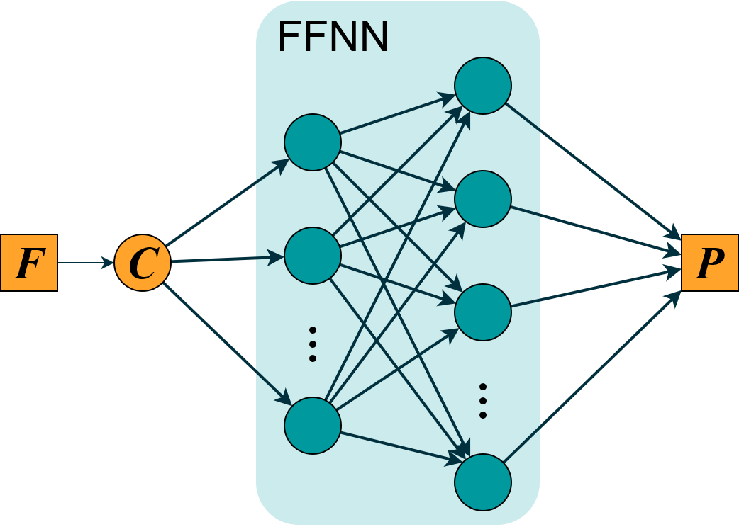


2 – 2.2
Naive Model
Physical conditions:
Objectivity
Material Symmetry
Thermodynamics
Polyconvexity/Ellipticity
Normalization
Growth Condition

Slide 10
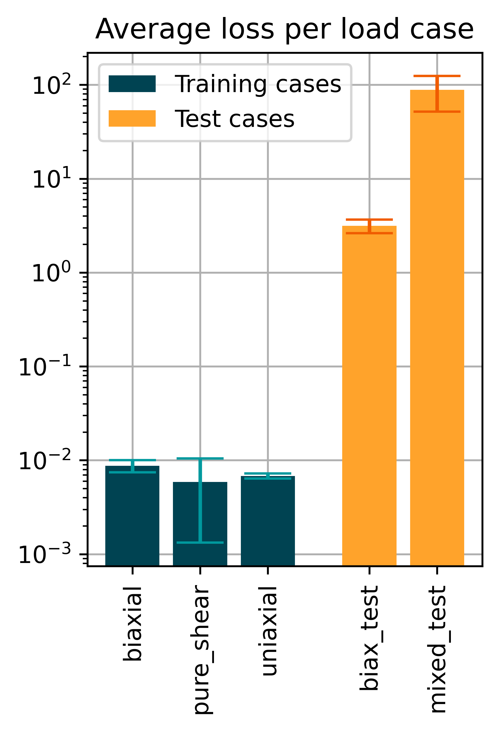
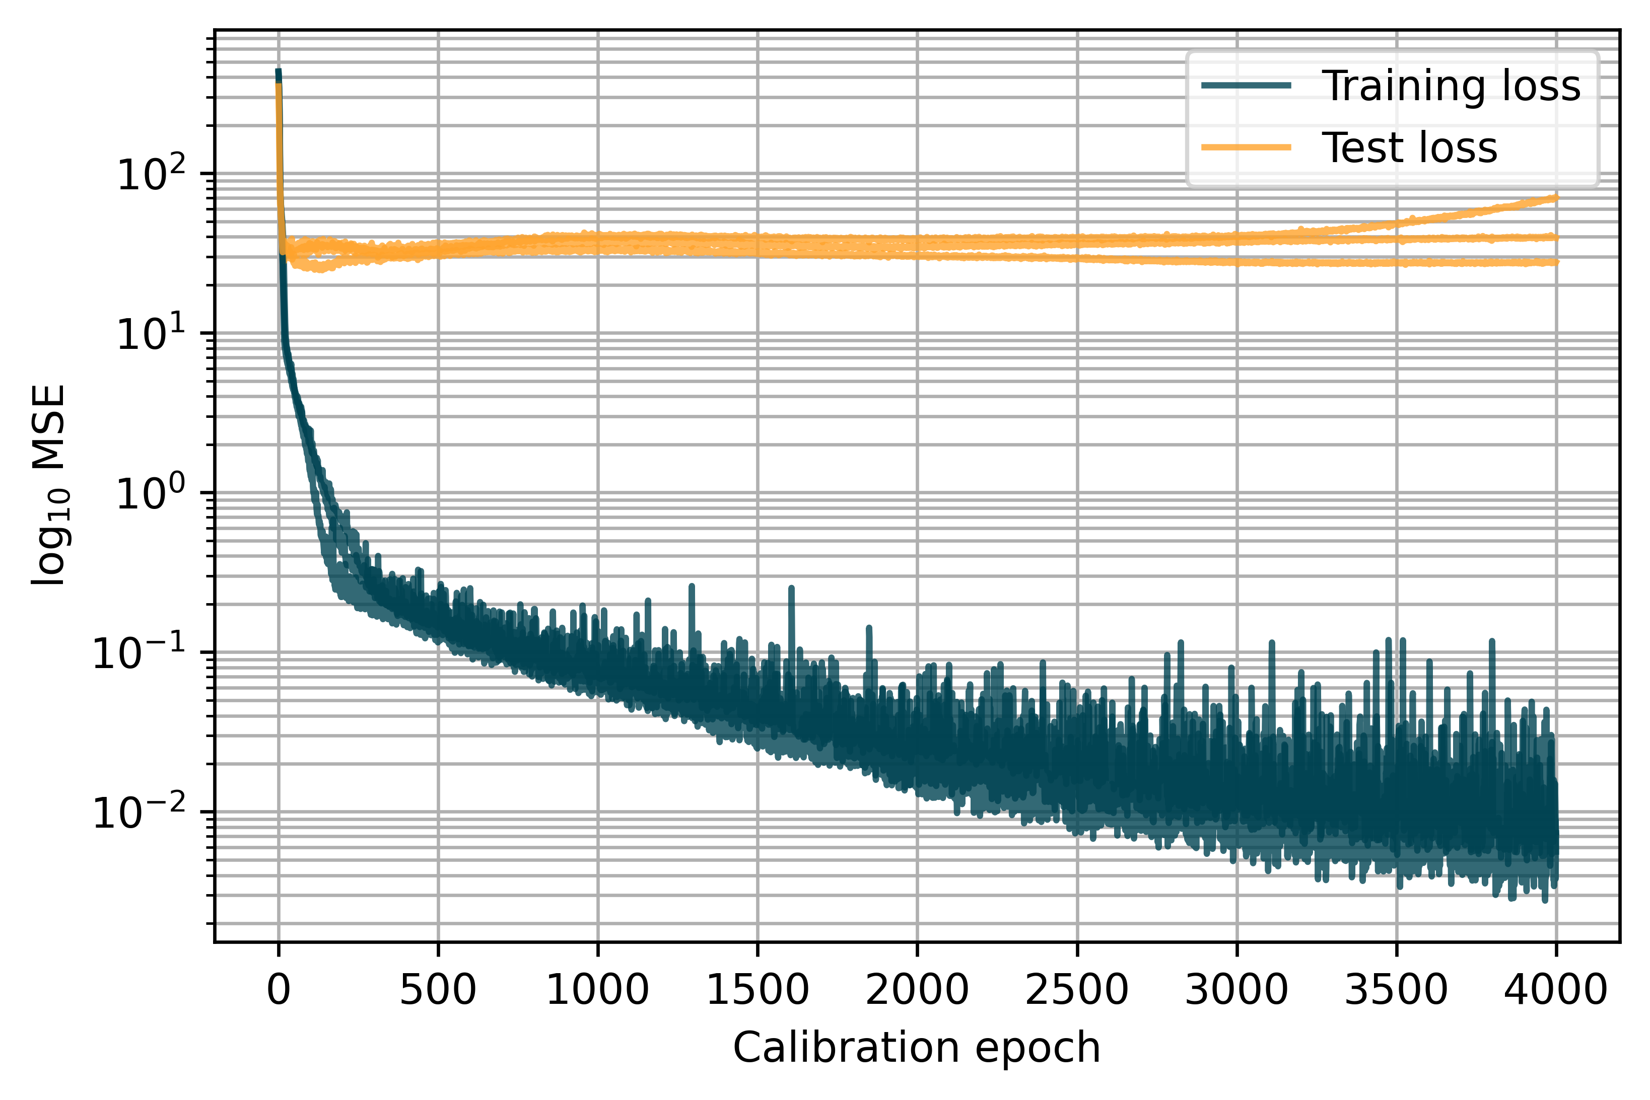
2 – 2.2
Naive Model
Layers: 16, 16, 9 Epochs: 4000 Learn rate: 0.005

Slide 11
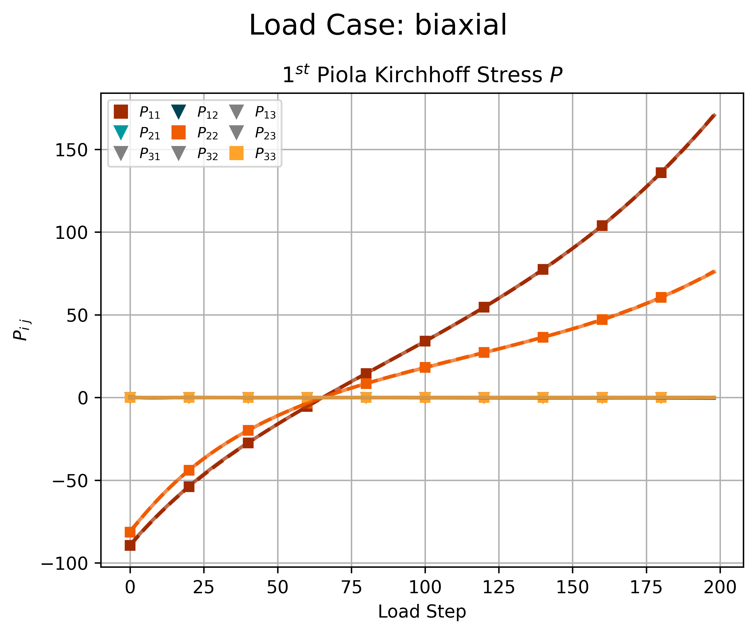
2 – 2.2
Naive Model - Biaxial

Slide 12
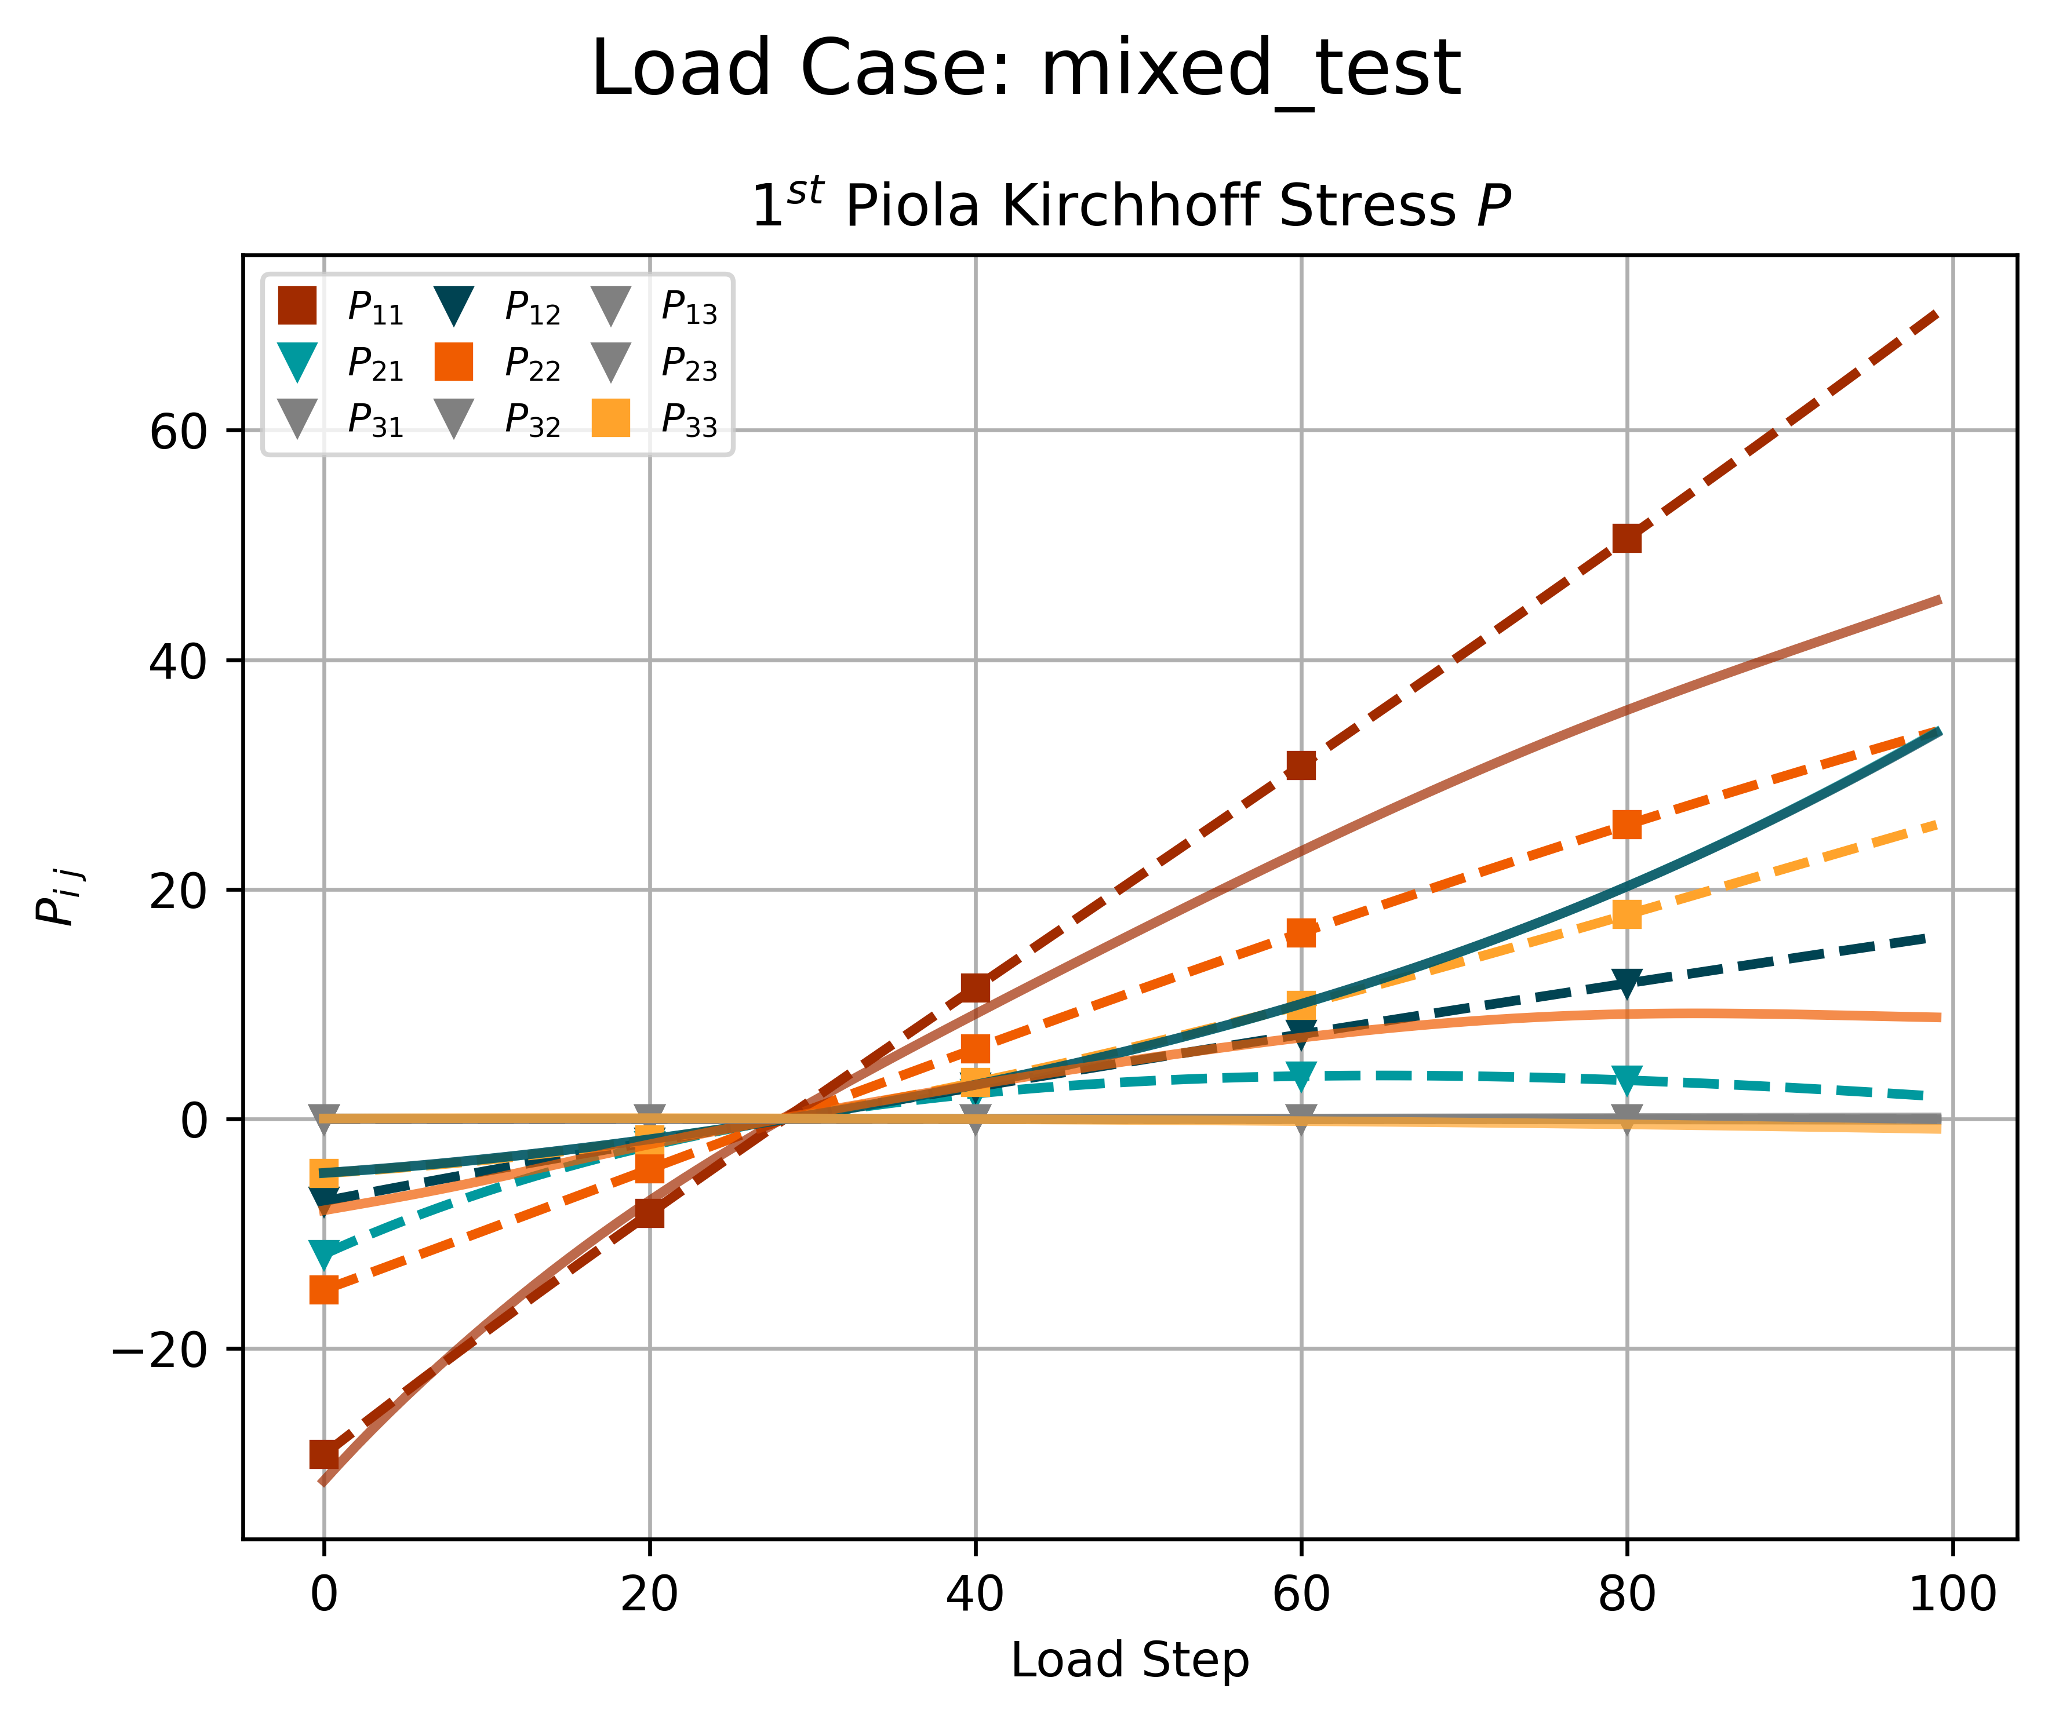
2 – 2.2
Naive Model - Mixed Test

Slide 13
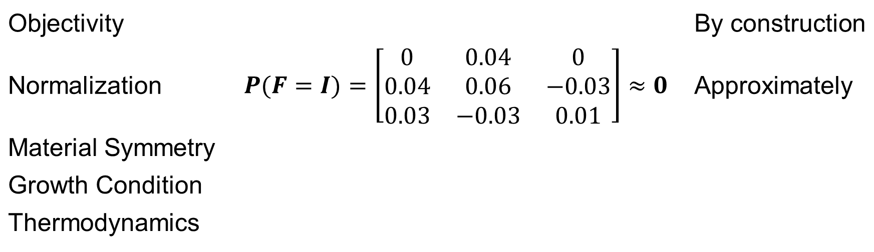
2 – 2.2
Naive Model – Physically Sensible?
Objectivity |  | By construction
Normalization | $$P(F=I)=\left[\begin{matrix}0 & 0.04 & 0 \\ 0.04 & 0.06 & −0.03 \\ 0.03 & −0.03 & 0.01\end{matrix}\right]≈0$$ | Approximately
Material Symmetry
Growth Condition
Thermodynamics

Slide 14
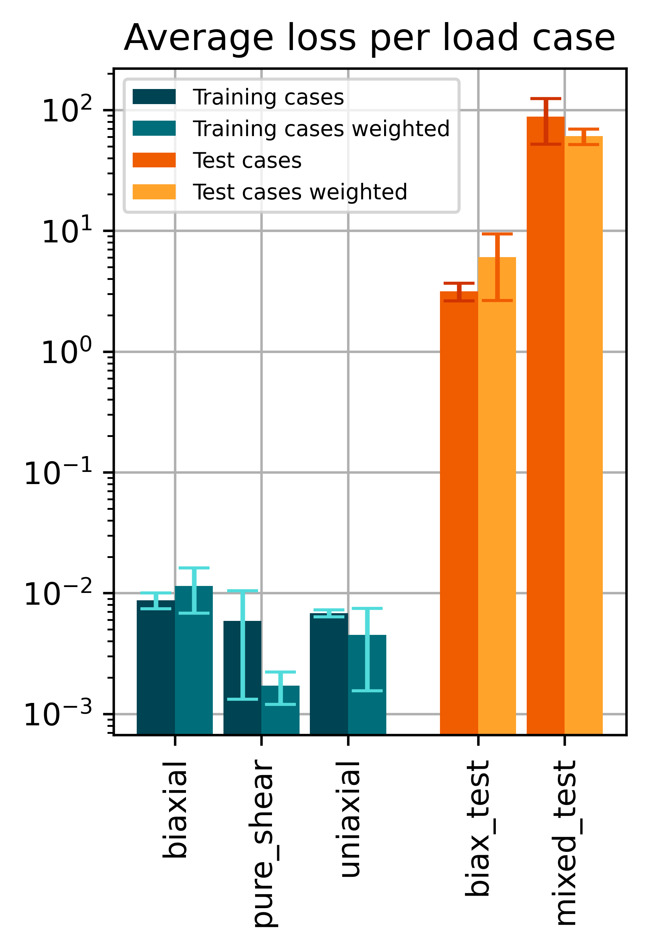
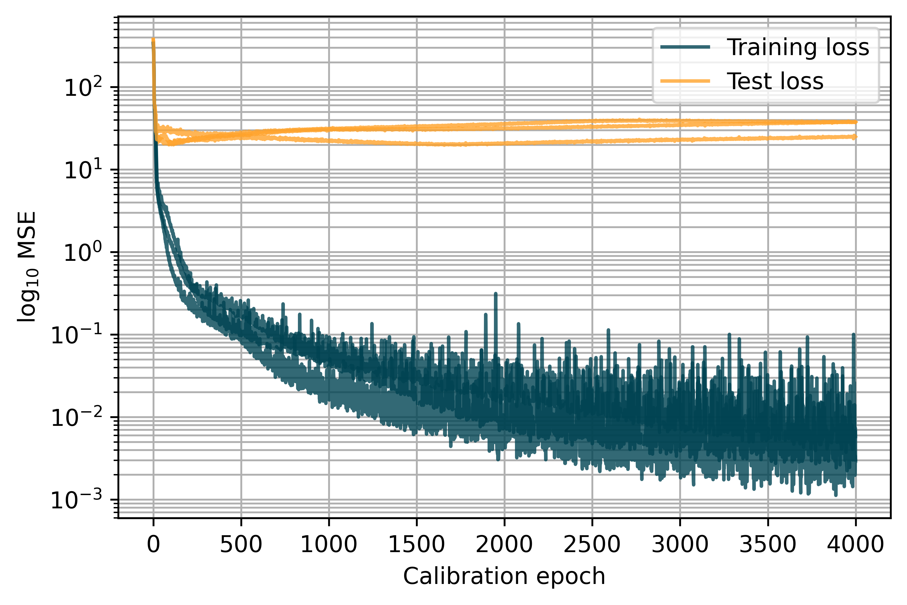
2 – 2.2
Naive Model - Loss weighting strategy
Layers: 16, 16, 9 Epochs: 4000 Learn rate: 0.005

Slide 15
2 – 2.2
Naive Model - Loss weighting strategy
Layers: 16, 16, 9 Epochs: 4000 Learn rate: 0.005
Weight diagram?
Notes:
Maybe add weights as a diagram

Slide 16
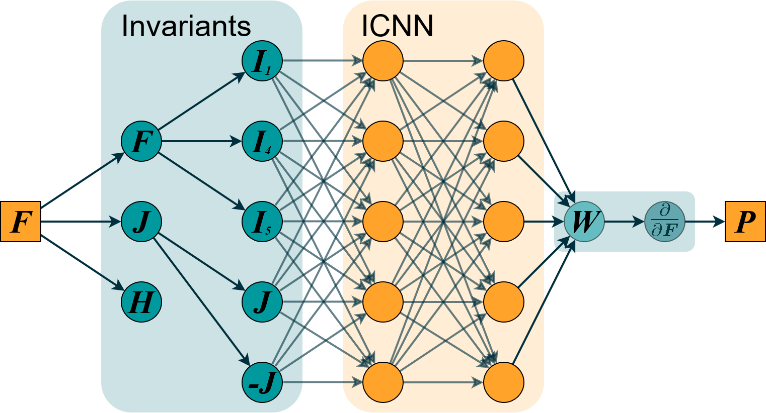
2 – 3.1
Physics-augmented model
Physical conditions:
Objectivity
Material Symmetry
Thermodynamics
Polyconvexity/Ellipticity
Normalization
Growth Condition
Notes:
Better Symbols for checkmarks, Animation, Grey out unimportant parts of architecture for every condition

Slide 17
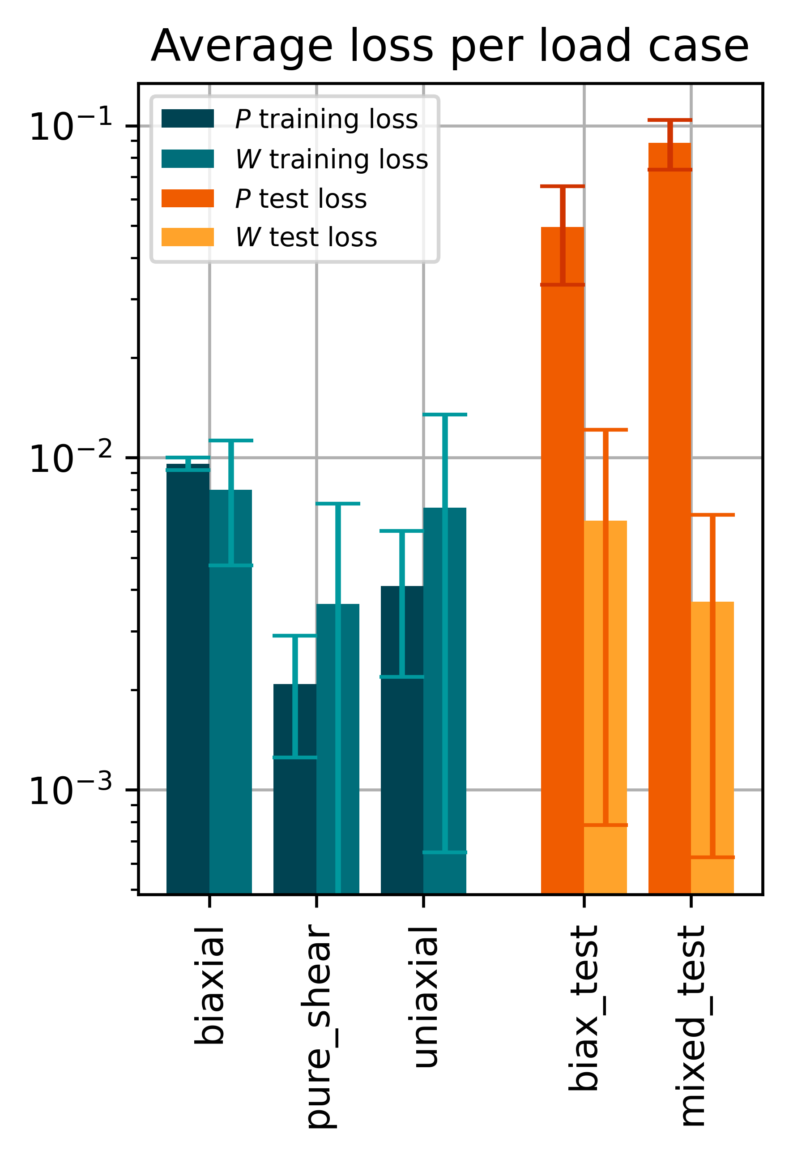
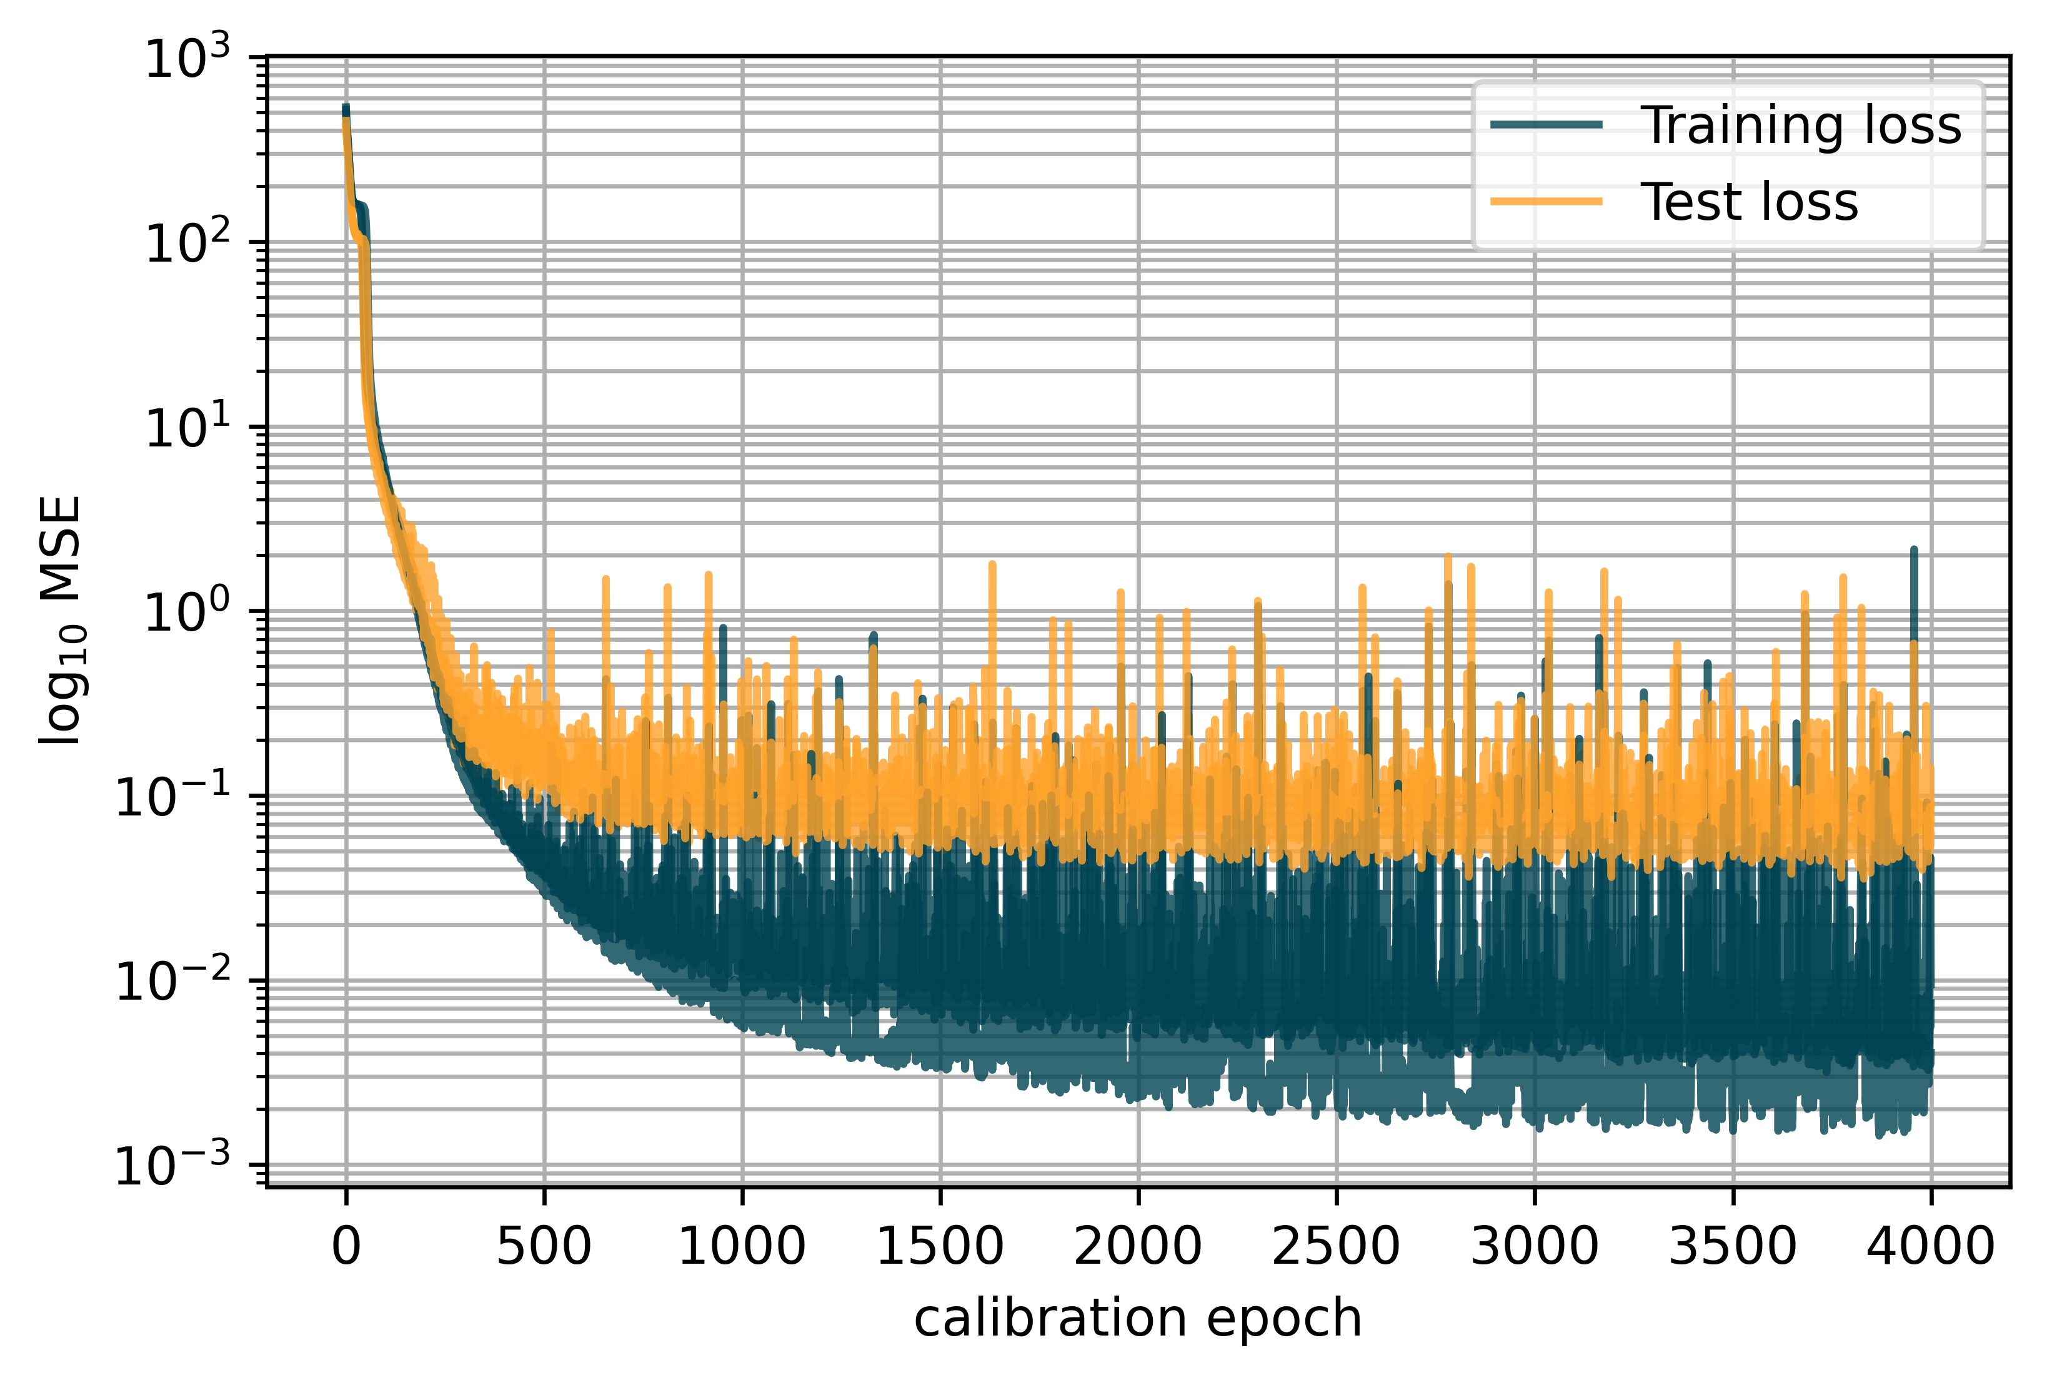
2 – 3.2
Physics-augmented model
Layers: 16, 16, 1 Epochs: 4000 Learn rate: 0.005
Notes:
Maybe add weights as a diagram

Slide 18
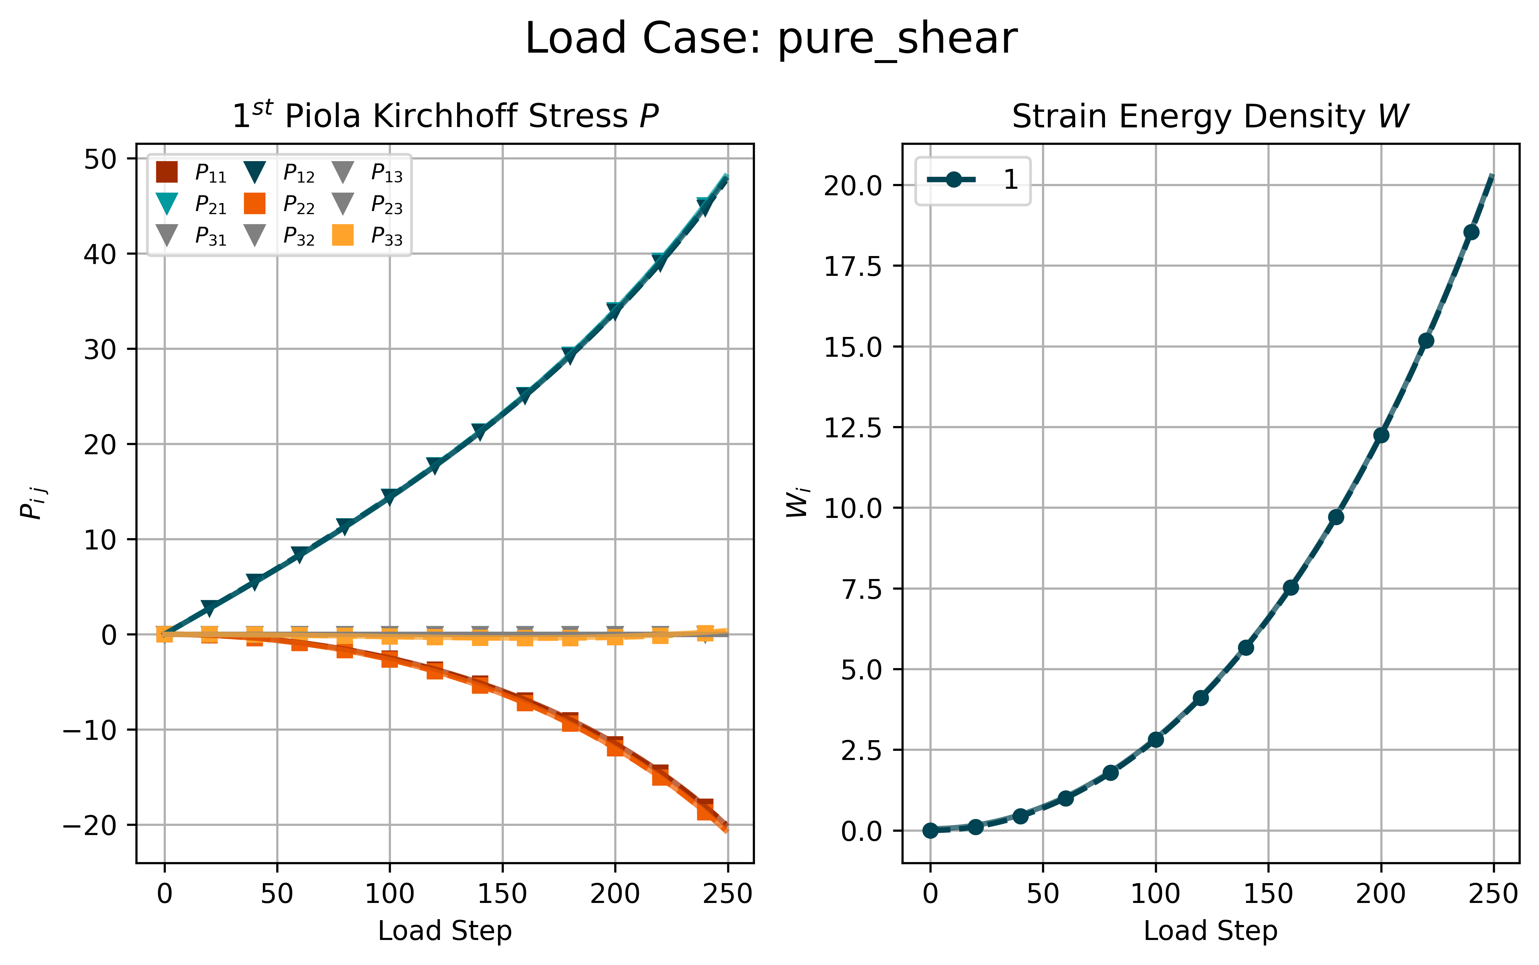
2 – 3.2
Physics-augmented model
Notes:
Maybe add weights as a diagram

Slide 19
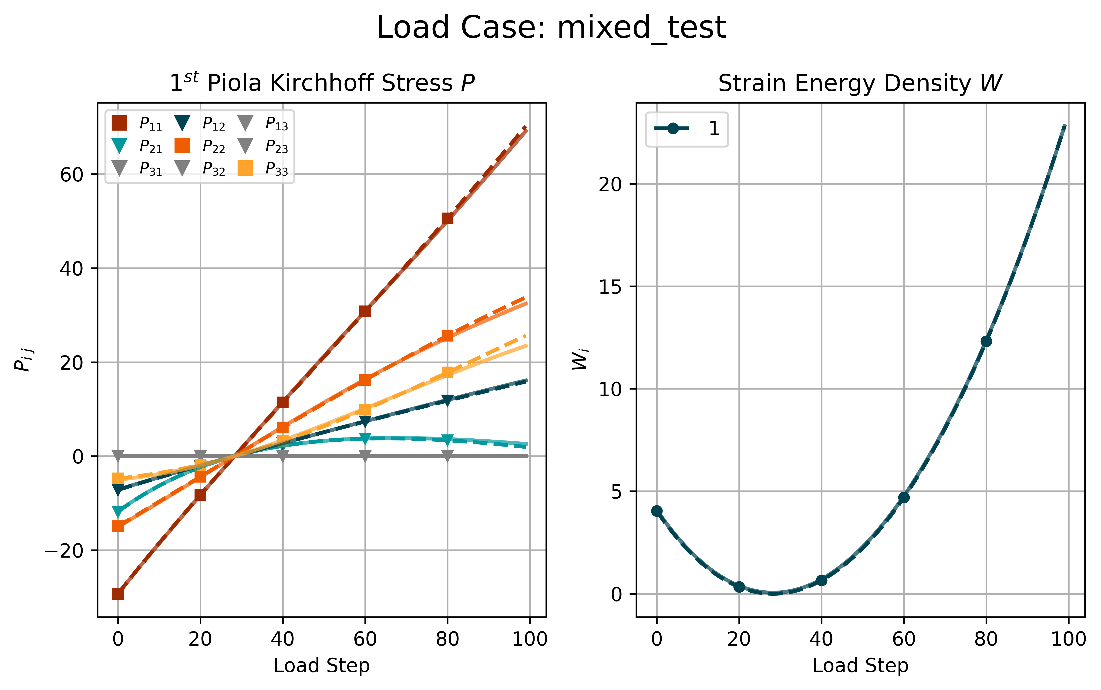
2 – 3.2
Physics-augmented model
Notes:
Maybe add weights as a diagram

Slide 20
2 – 3.2
Physics-augmented model
For F = I the model predicts:
W = [[-0.05794334]],
P =
[[[-0.04460907 0. 0. ]
[ 0. 0.01268005 0. ]
[ 0. 0. 0.01268005]]]
=
[[[-0.04 0. 0. ]
[ 0. 0.01 0. ]
[ 0. 0. 0.01]]]

Slide 21
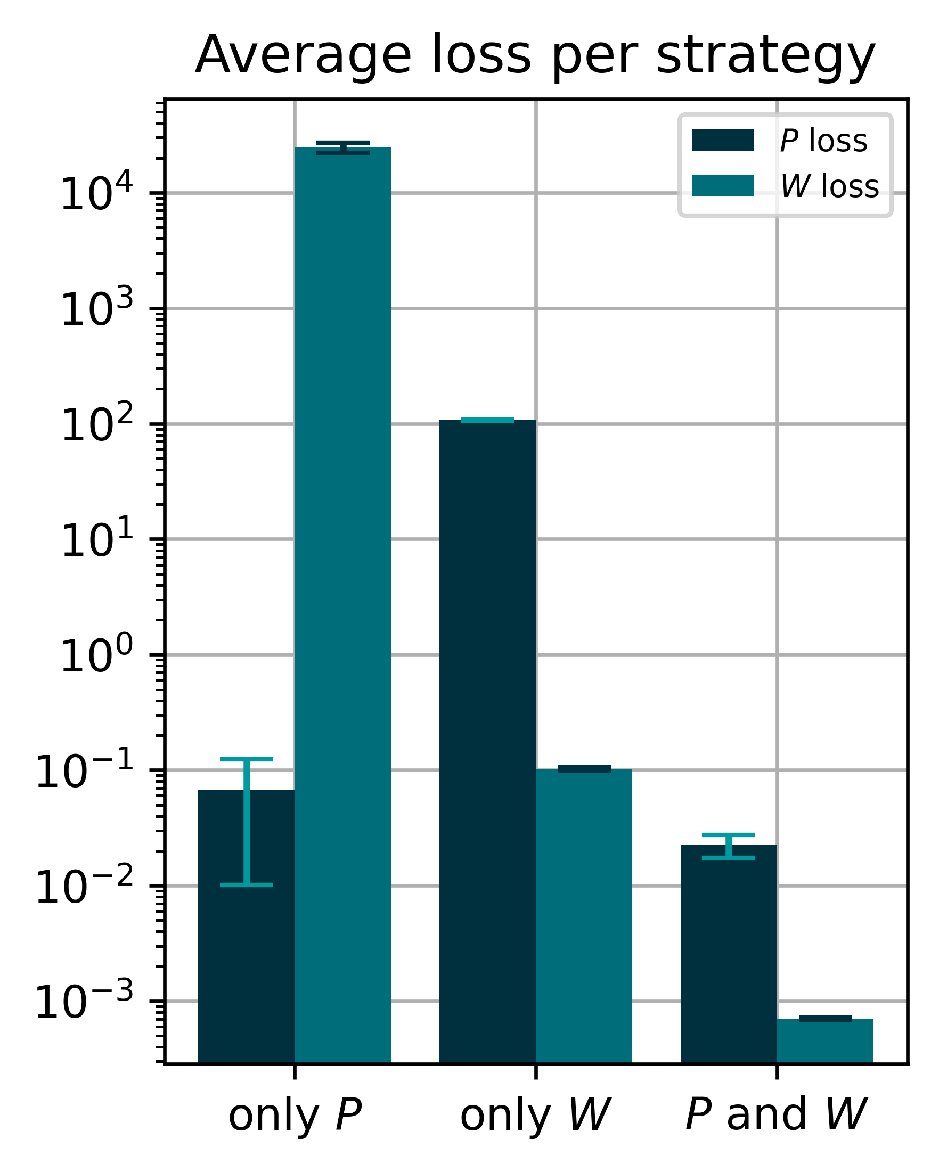
2 – 3.2
Physics-augmented model
Layers: 16, 16, 1 Epochs: 4000 Learn rate: 0.005

Slide 22
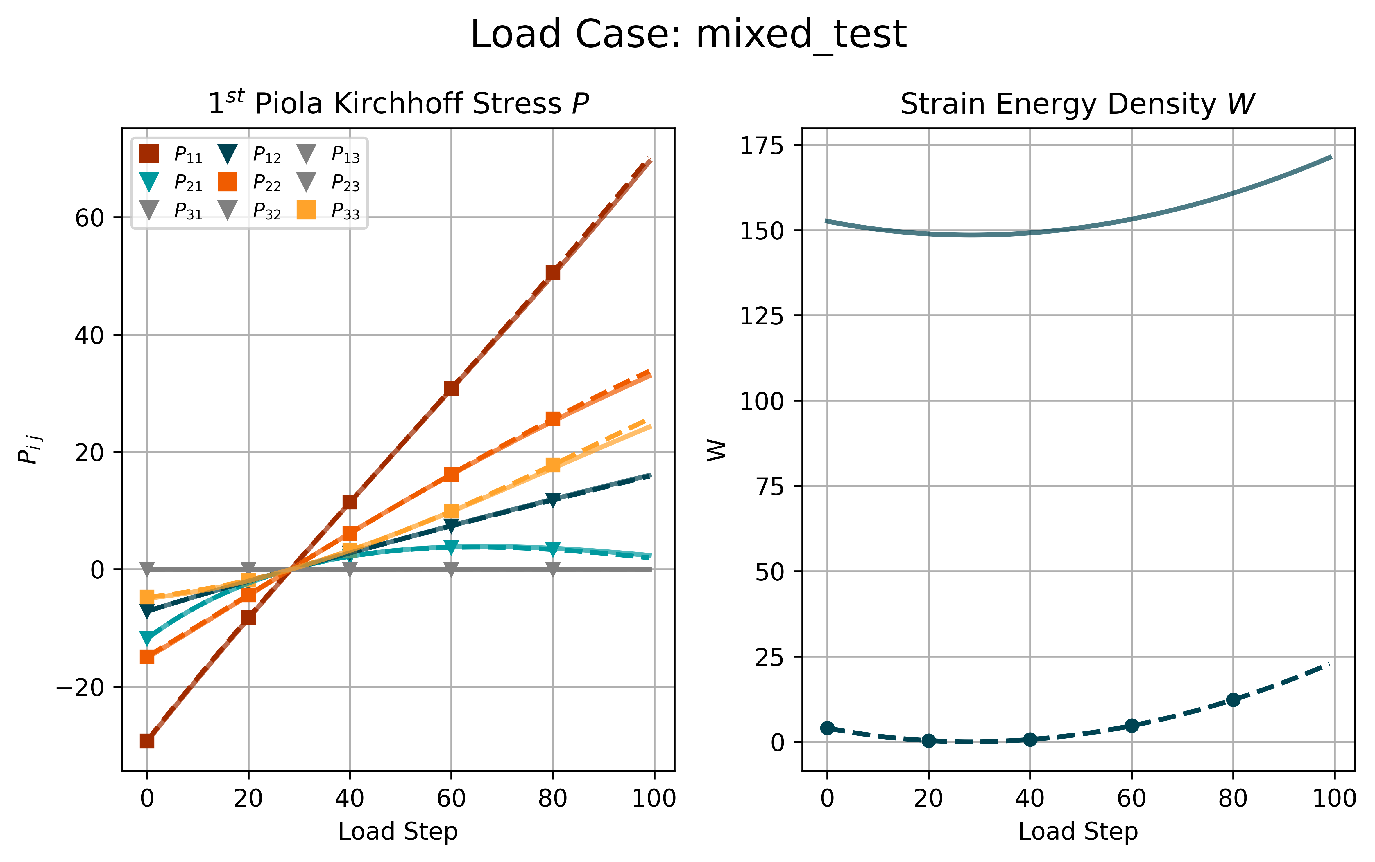
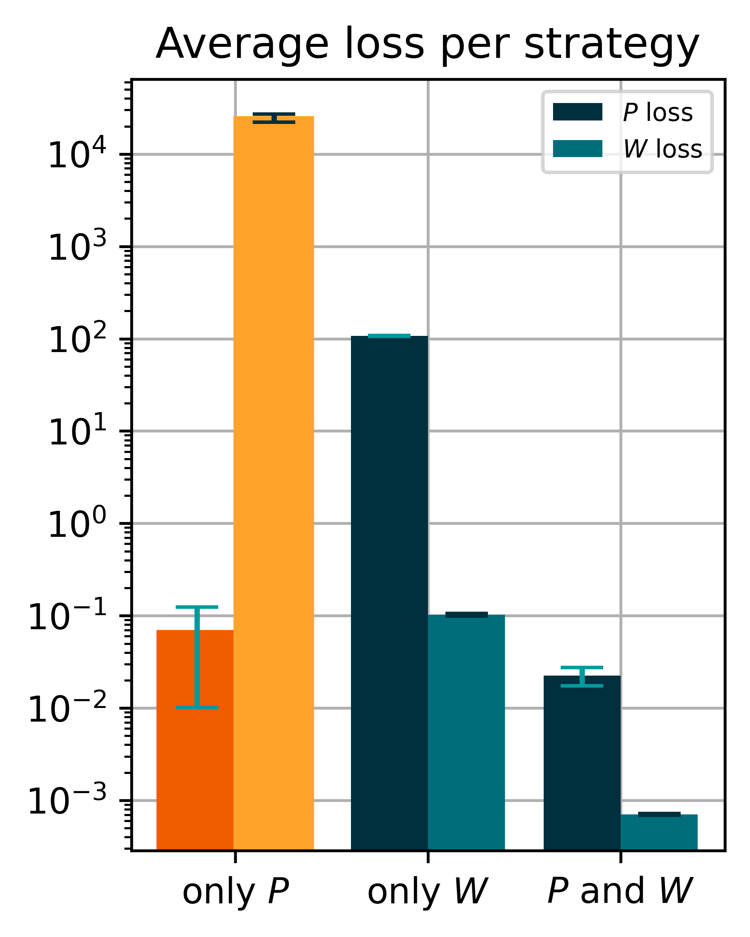
2 – 3.2
Physics-augmented model
Layers: 16, 16, 1 Epochs: 4000 Learn rate: 0.005

Slide 23
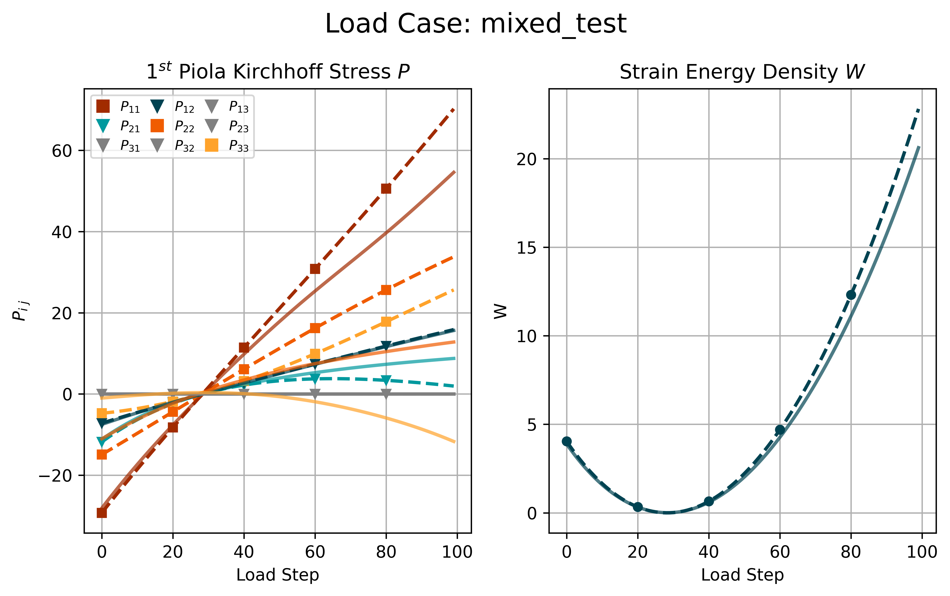
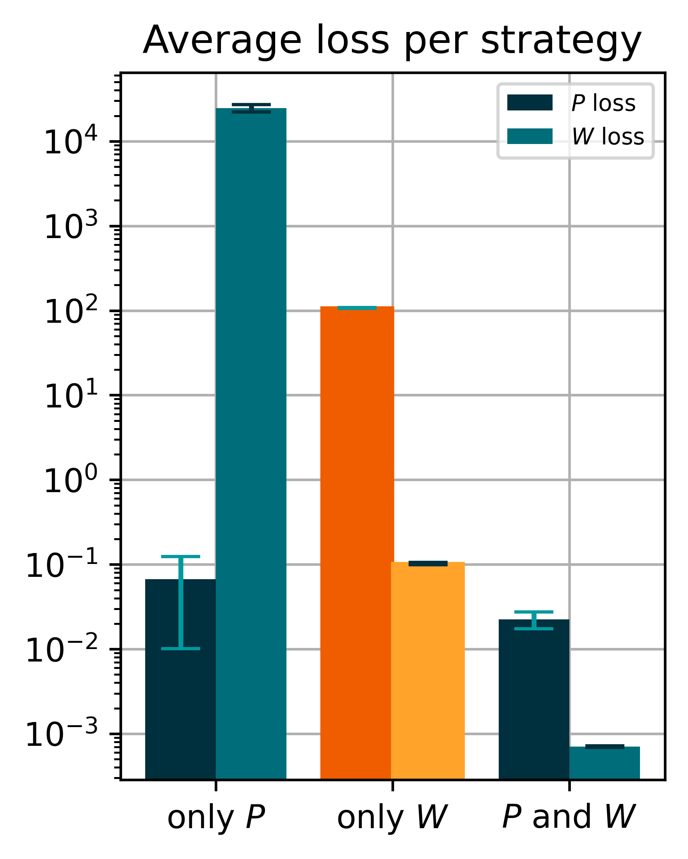
2 – 3.2
Physics-augmented model
Layers: 16, 16, 1 Epochs: 4000 Learn rate: 0.005

Slide 24
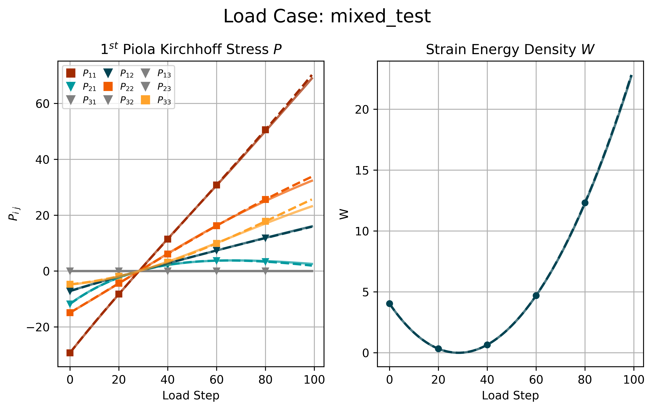
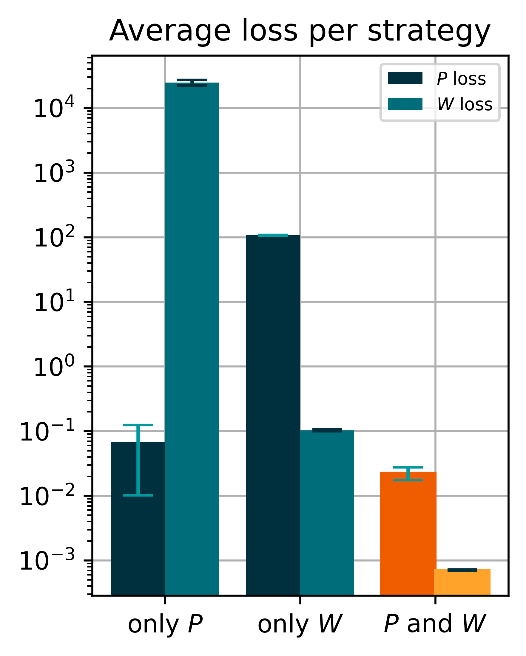
2 – 3.2
Physics-augmented model
Layers: 16, 16, 1 Epochs: 4000 Learn rate: 0.005

Slide 25
2 – 3.2
Physics-augmented model
Use different load paths for the calibration of the
model, e.g. only uniaxial tension. Is the model still
able to extrapolate to the other cases?

Slide 26
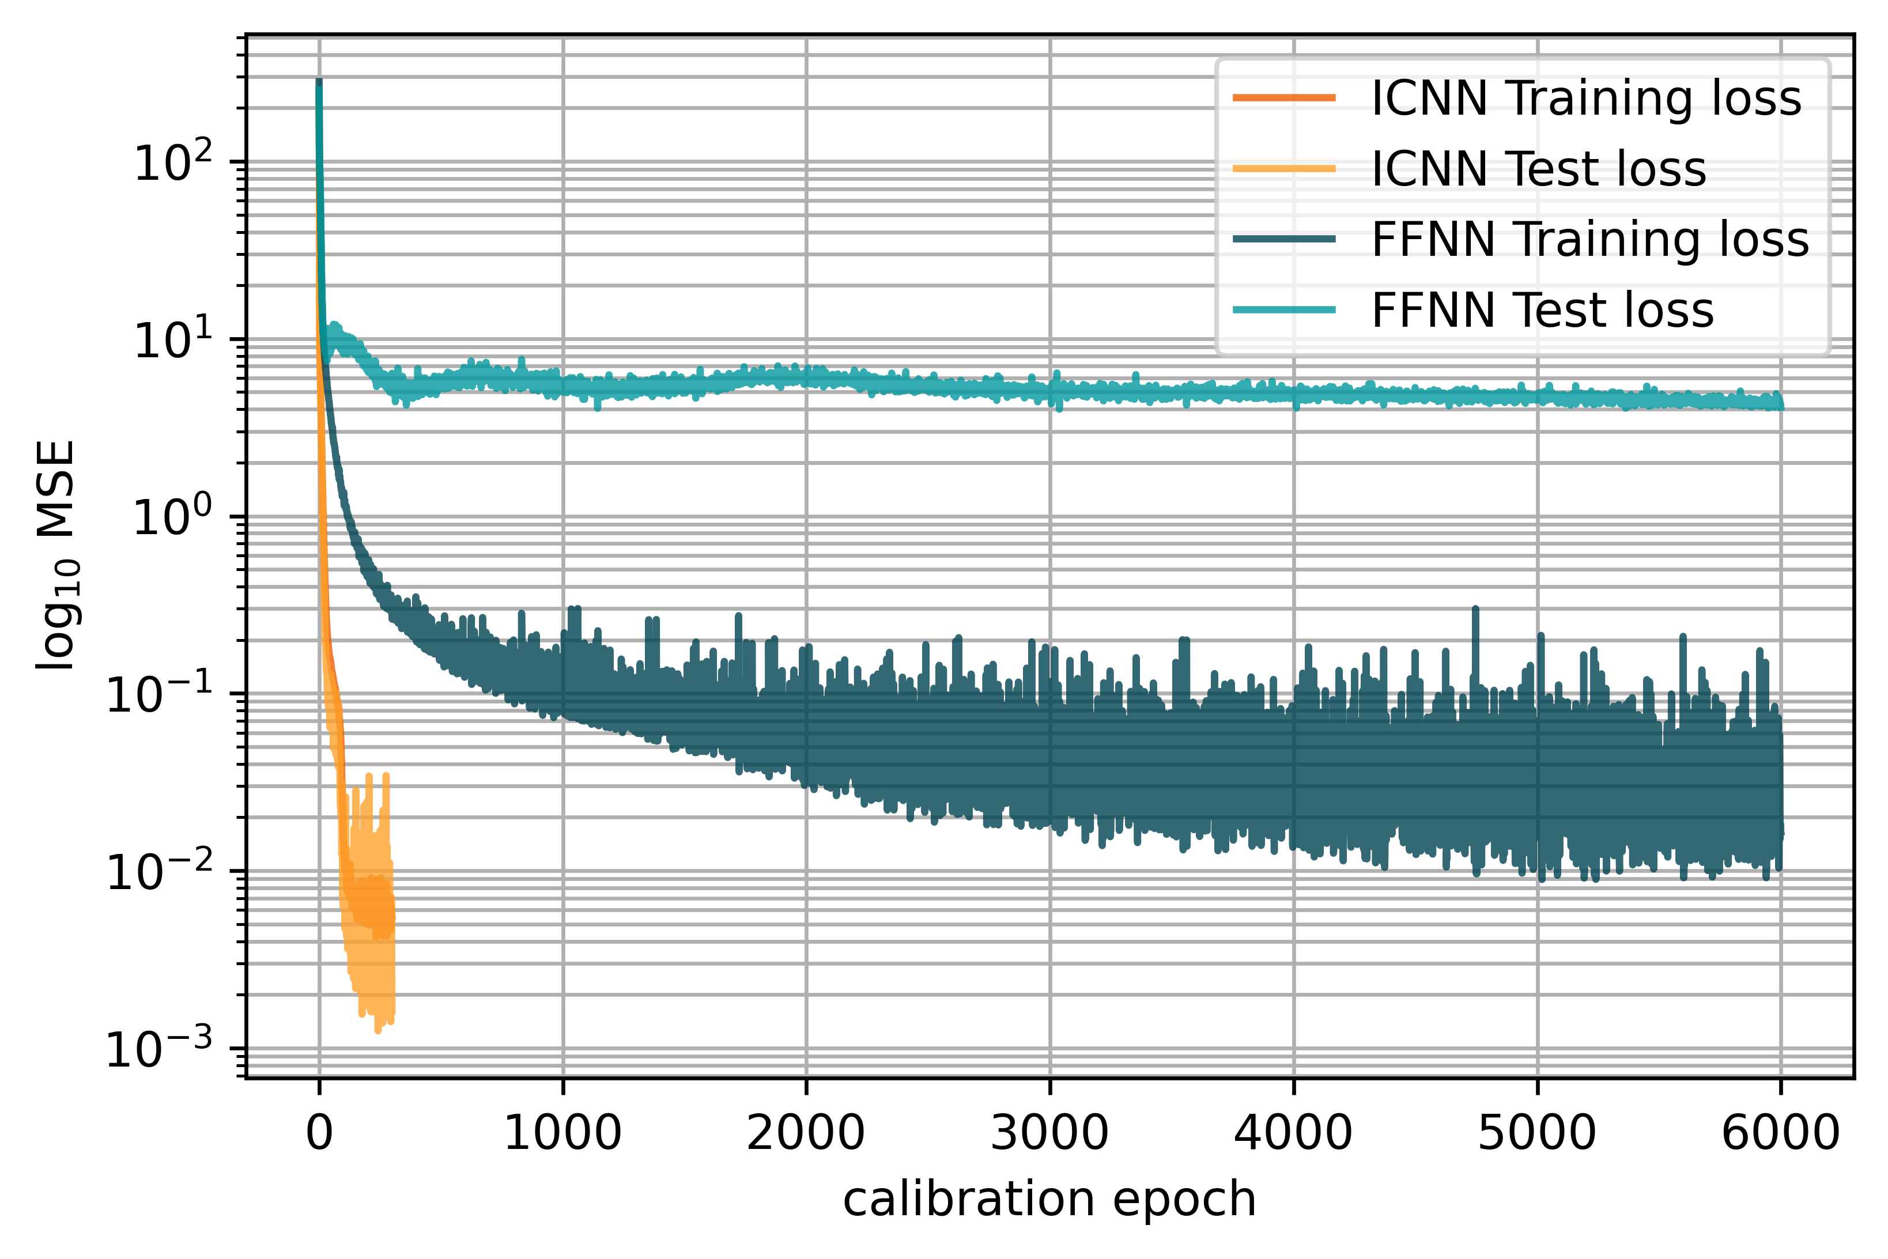
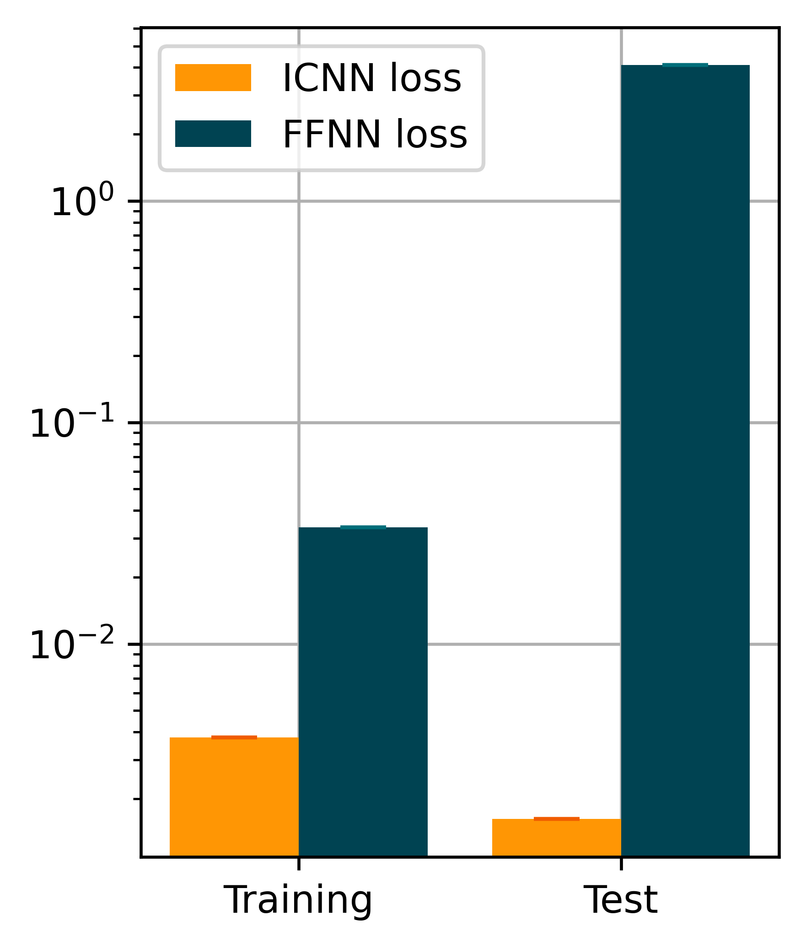
2 – 4
Concentric sampled deformation gradients
ICNN: Layers: 8, 8, 1 Epochs: 300 Learn rate: 0.002
FFNN: Layers: 32,32,16, 9 Epochs: 6000 Learning rate: 0.002
95/5
Split

Slide 27
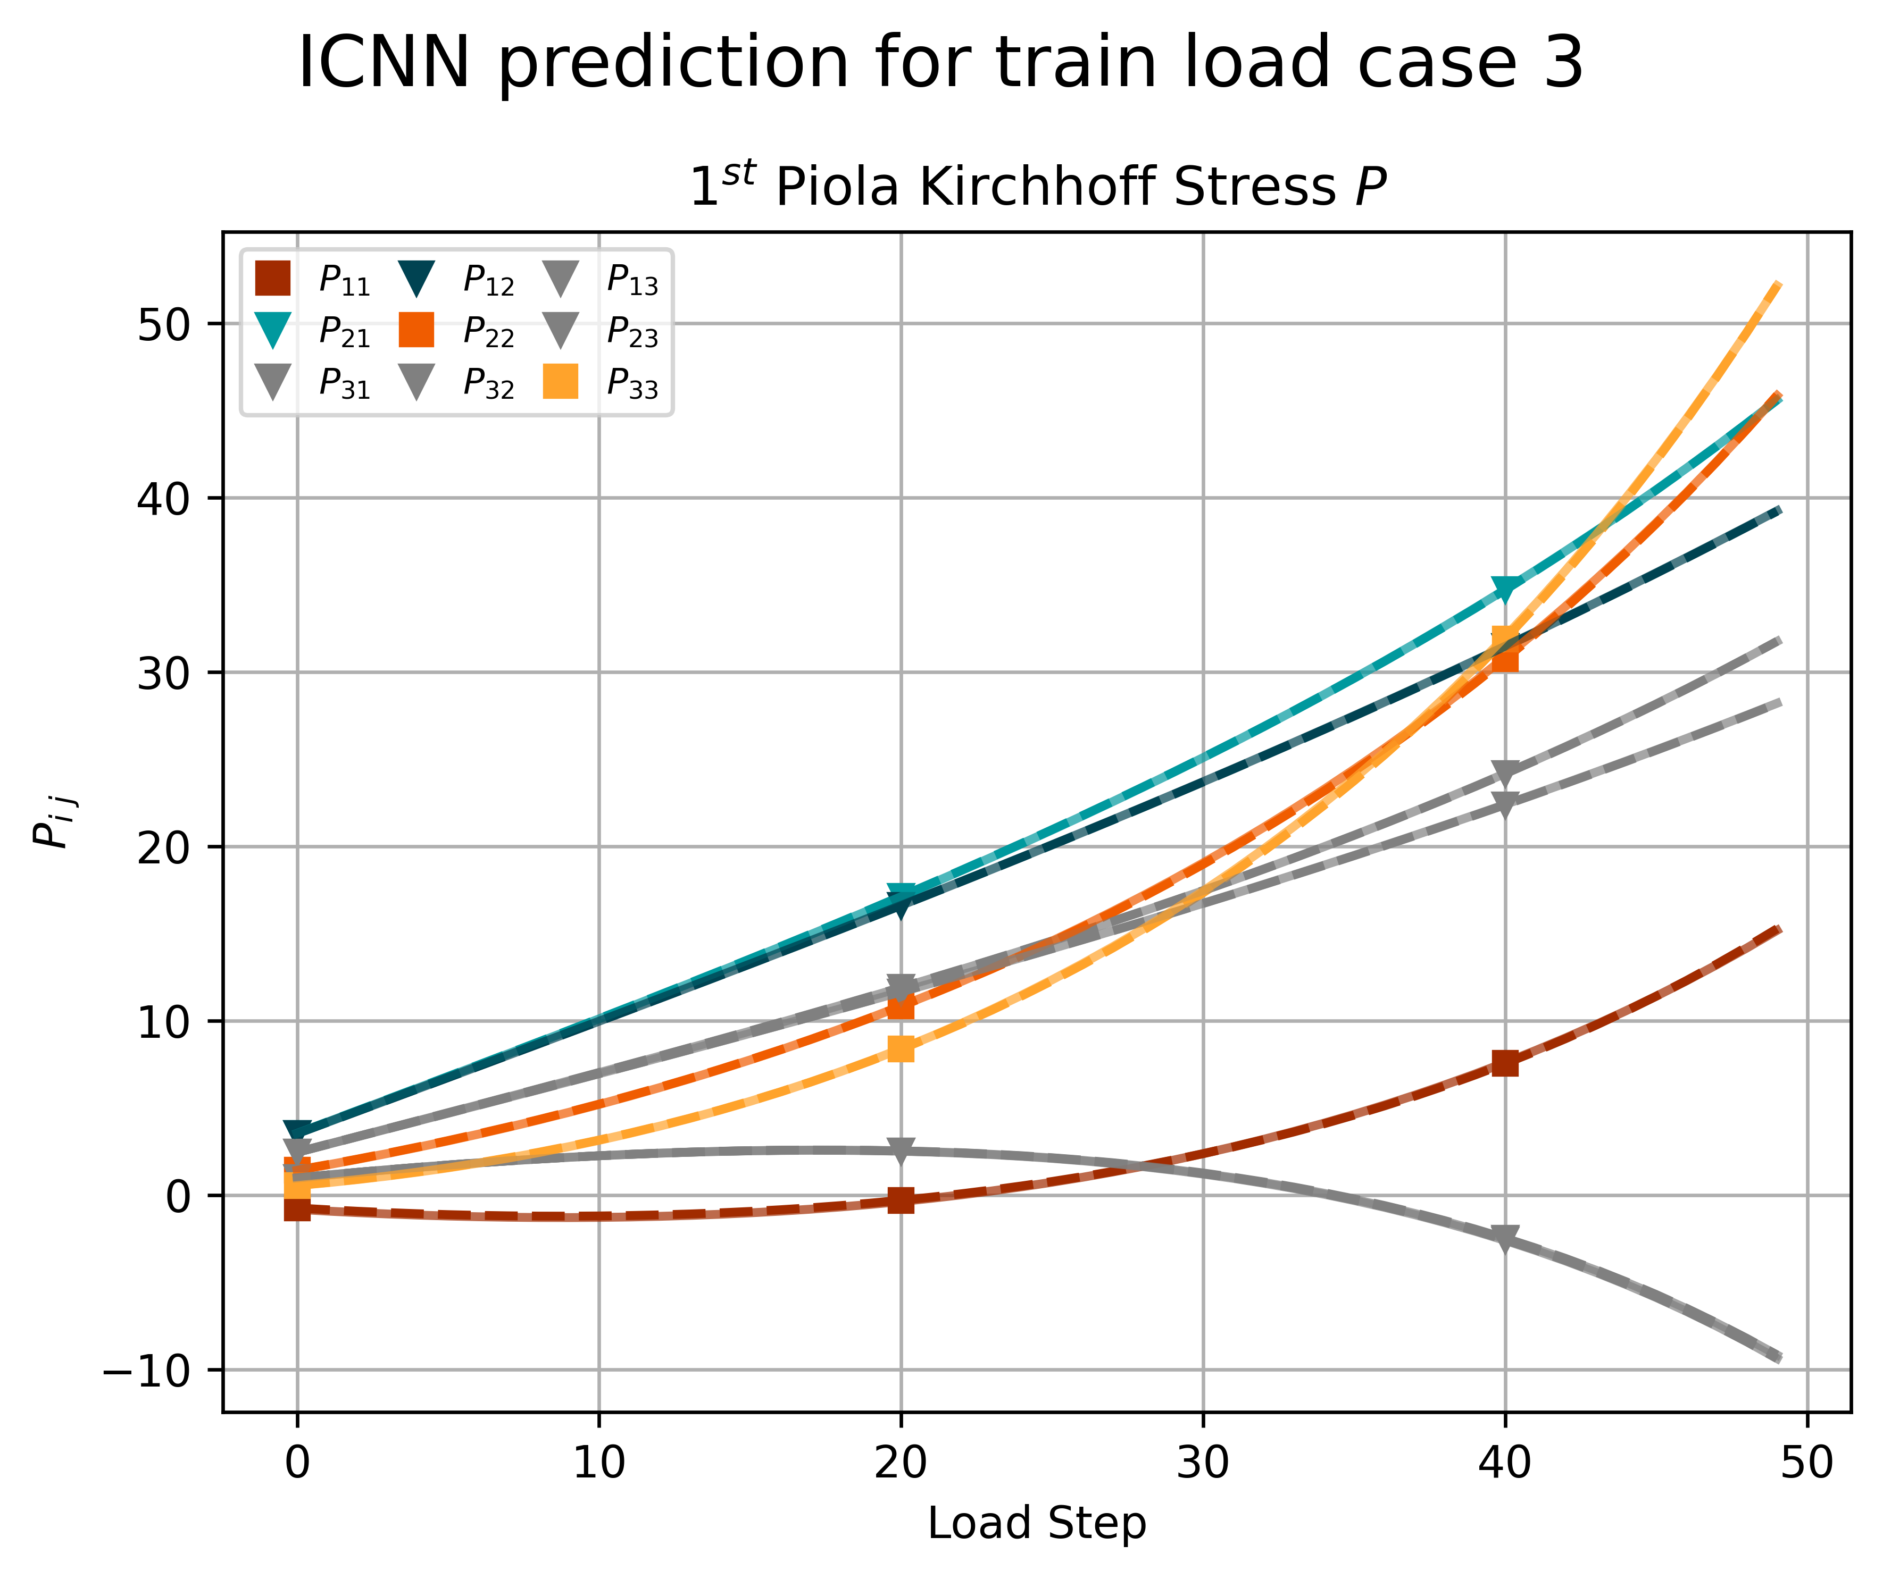
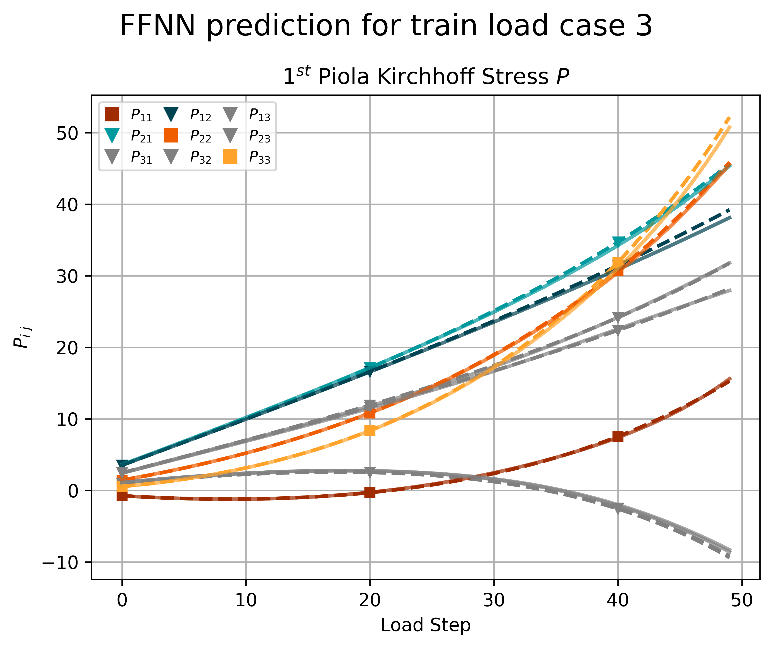
2 – 4
Concentric sampled deformation gradients
95/5
Split

Slide 28
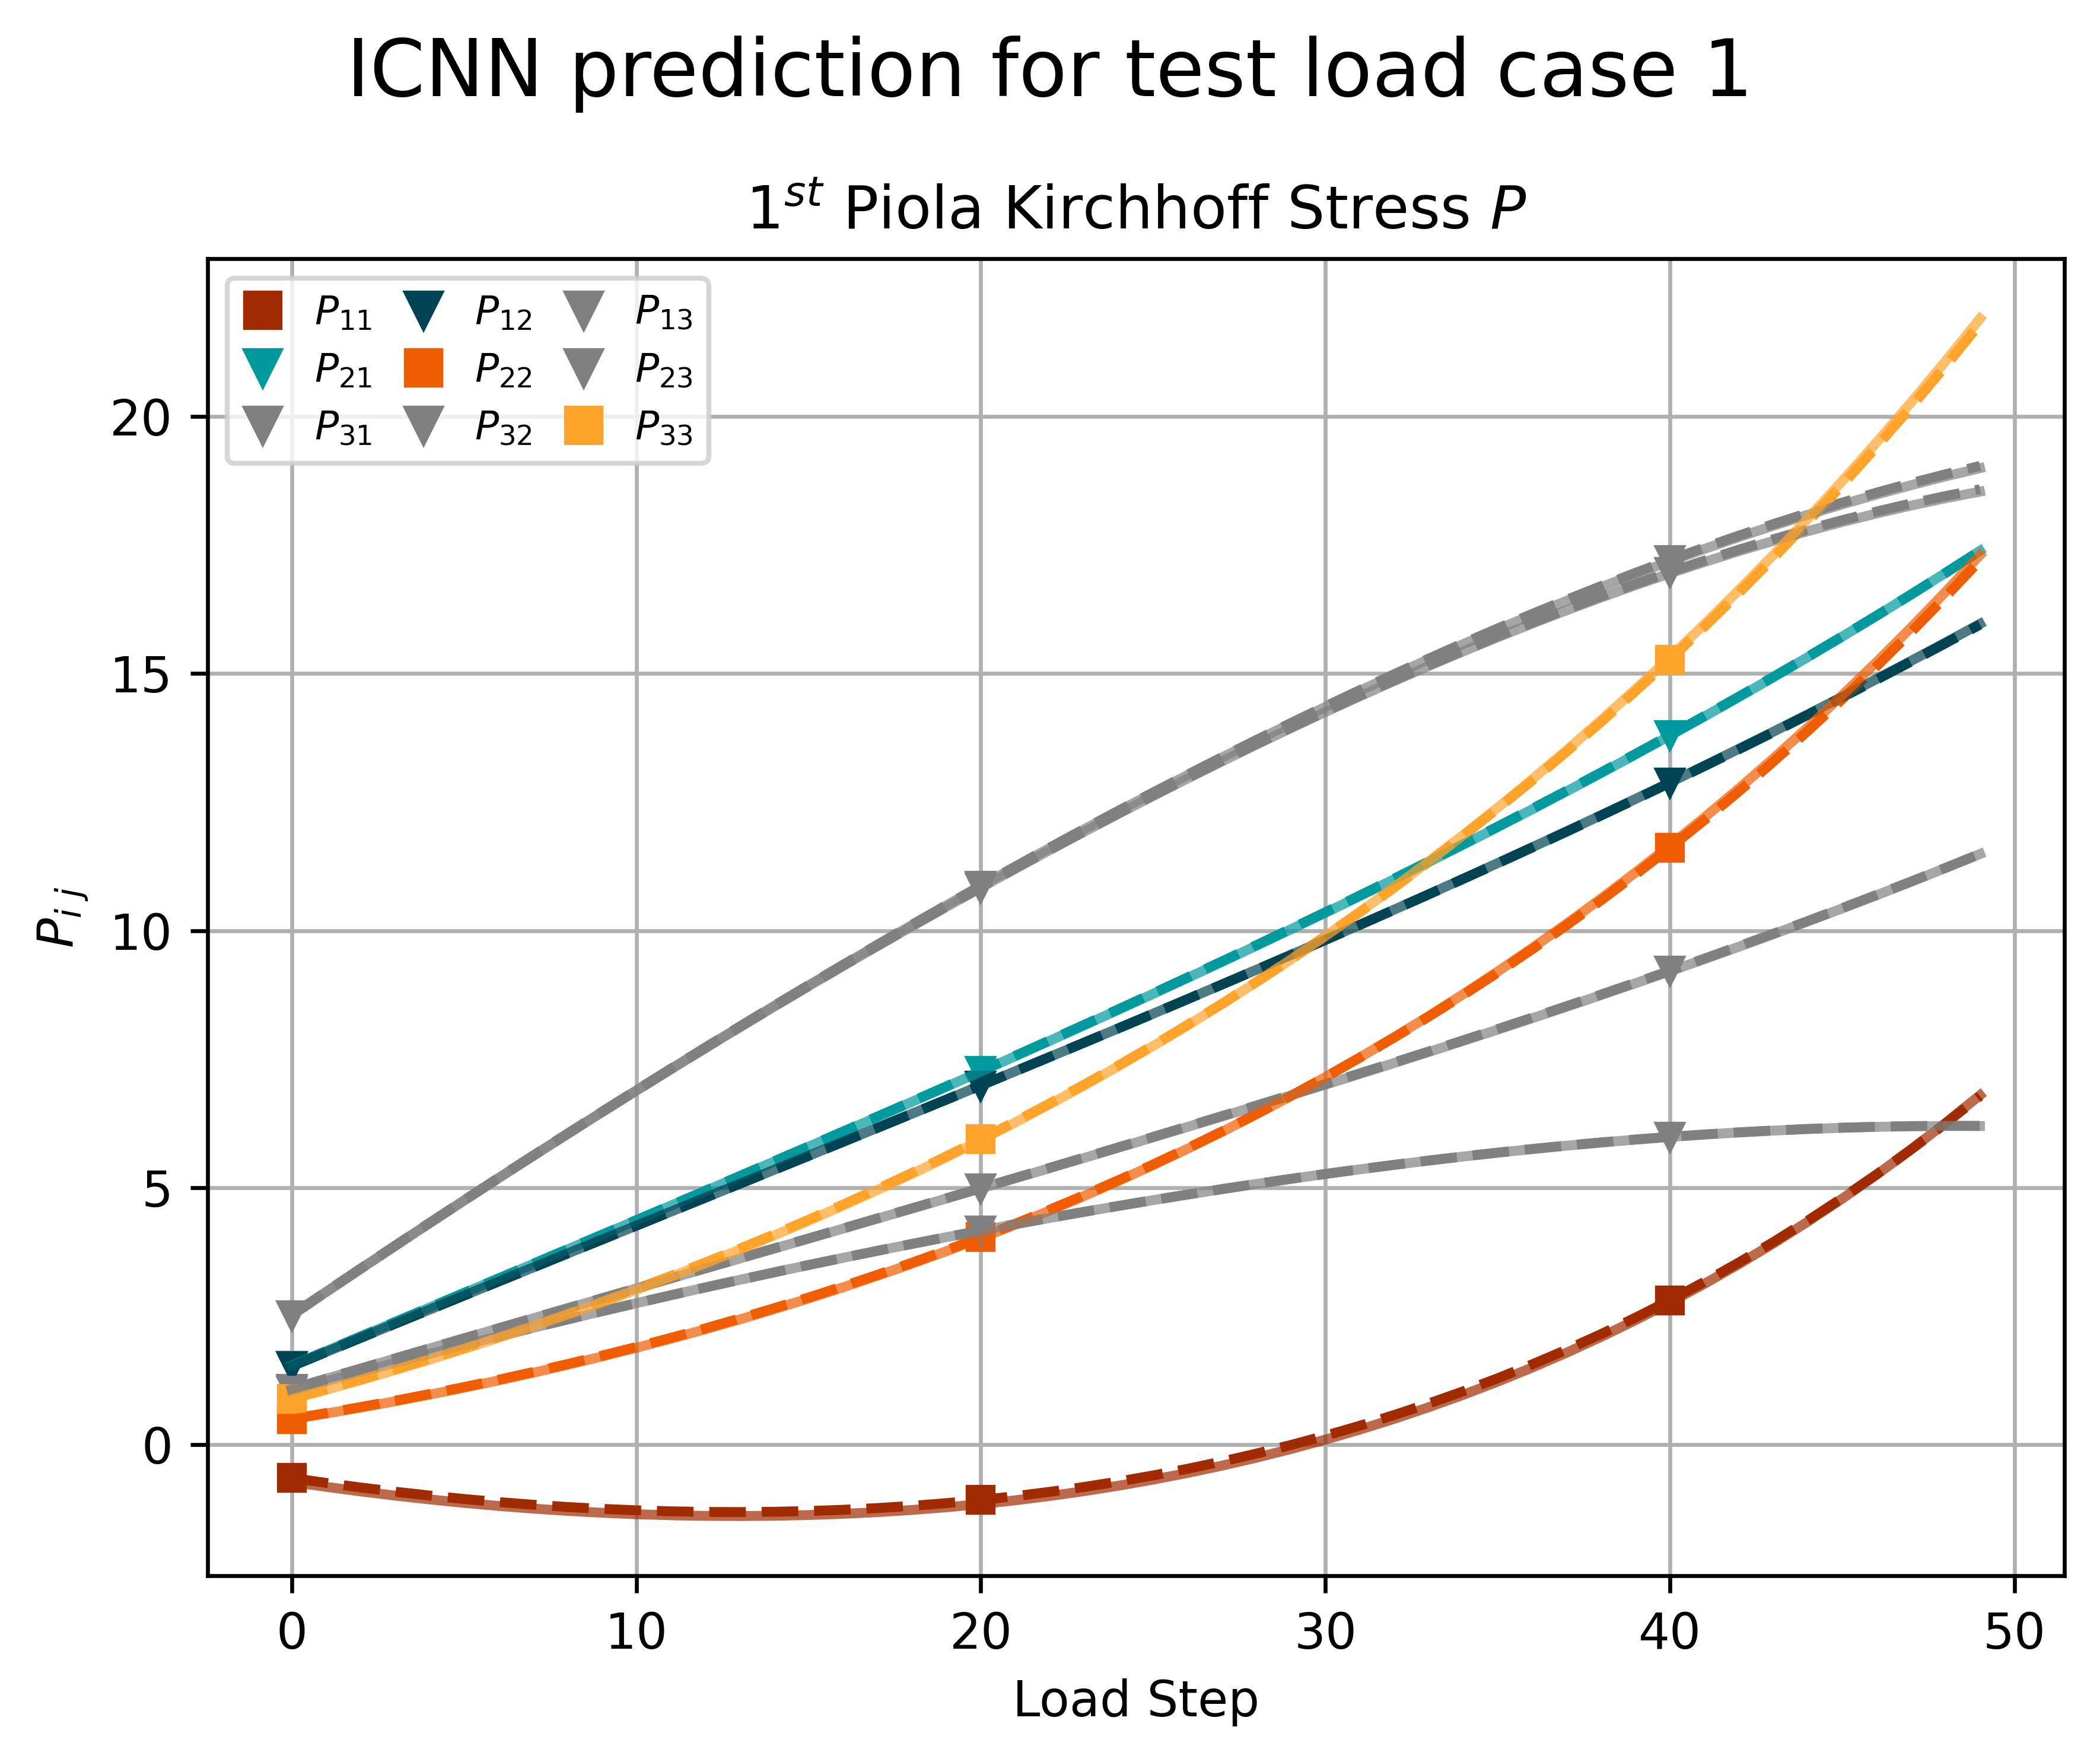
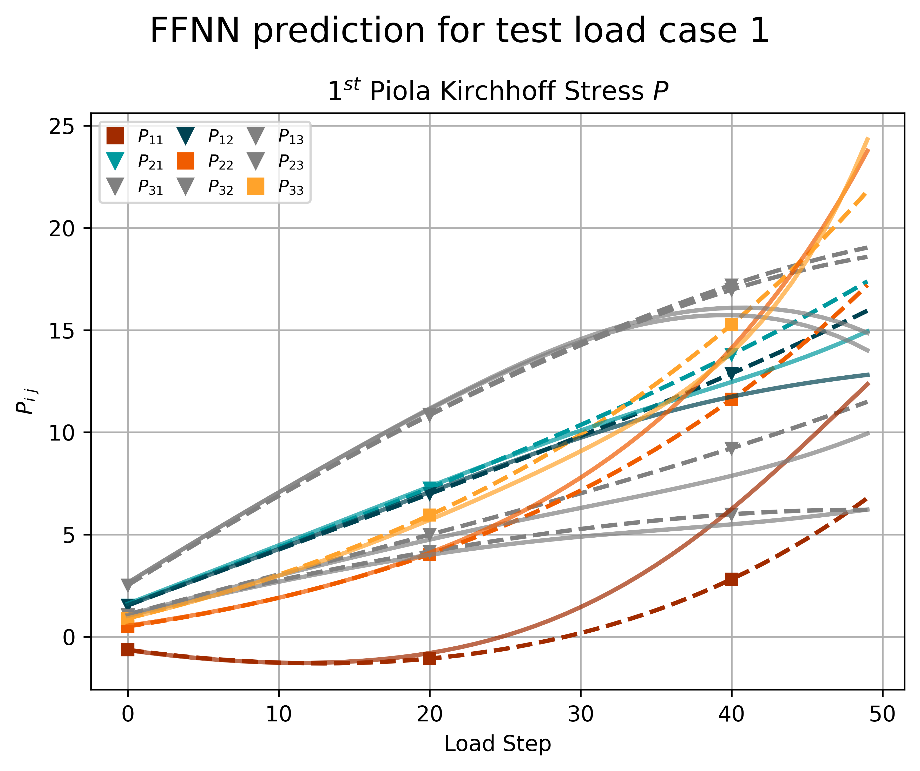
2 – 4
Concentric sampled deformation gradients
95/5
Split

Slide 29
What differences do you observe in the generalization of the models? What difference do you observe in the required network size
/ calibration dataset size? What is the smallest possible architecture for each model? What is the inductive bias, c.f. Haussler [1], of
both NN models?

Slide 30
Task 3
Hyperelasticity II

Slide 31
Why is it not possible to use batch normalization for this model?
• What are the benefits of scaling the output as in eq. (1)?

Slide 32
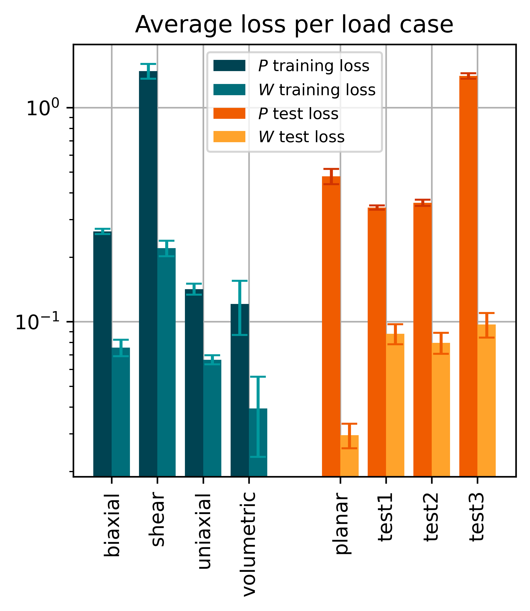
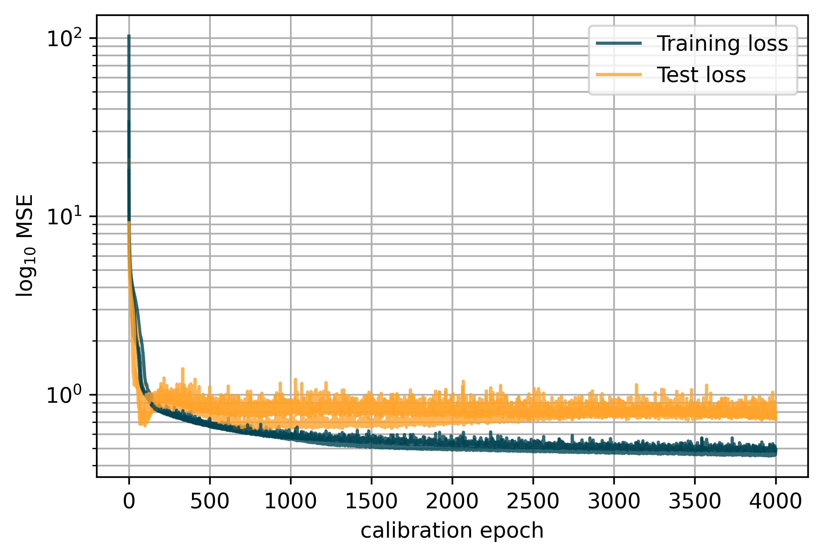
3 – 1.2
Invariant-based model
Layers: 16, 16, 1 Epochs: 4000 Learn rate: 0.005
Notes:
Maybe add weights as a diagram

Slide 33
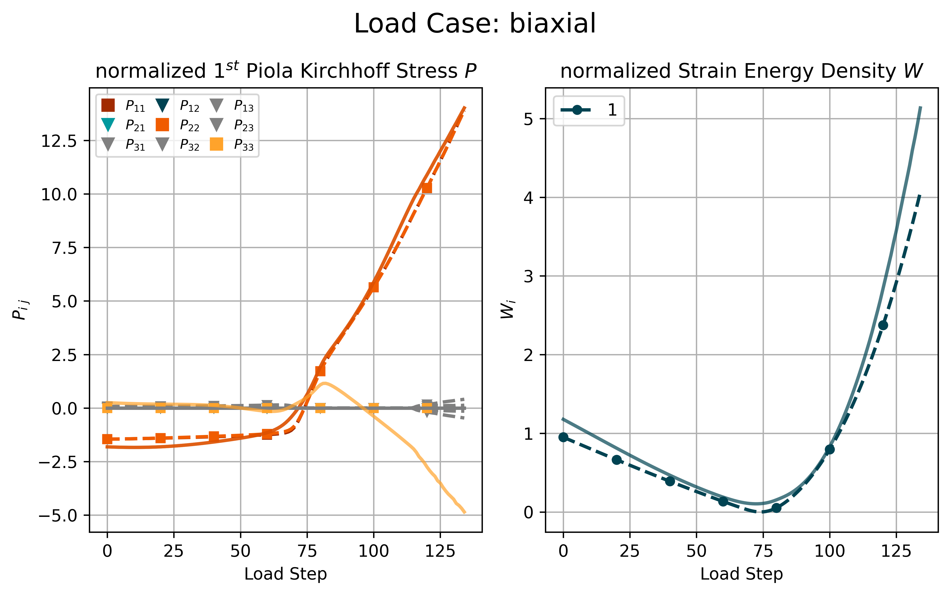
3 – 1.2
Invariant-based model
Notes:
Maybe add weights as a diagram

Slide 34
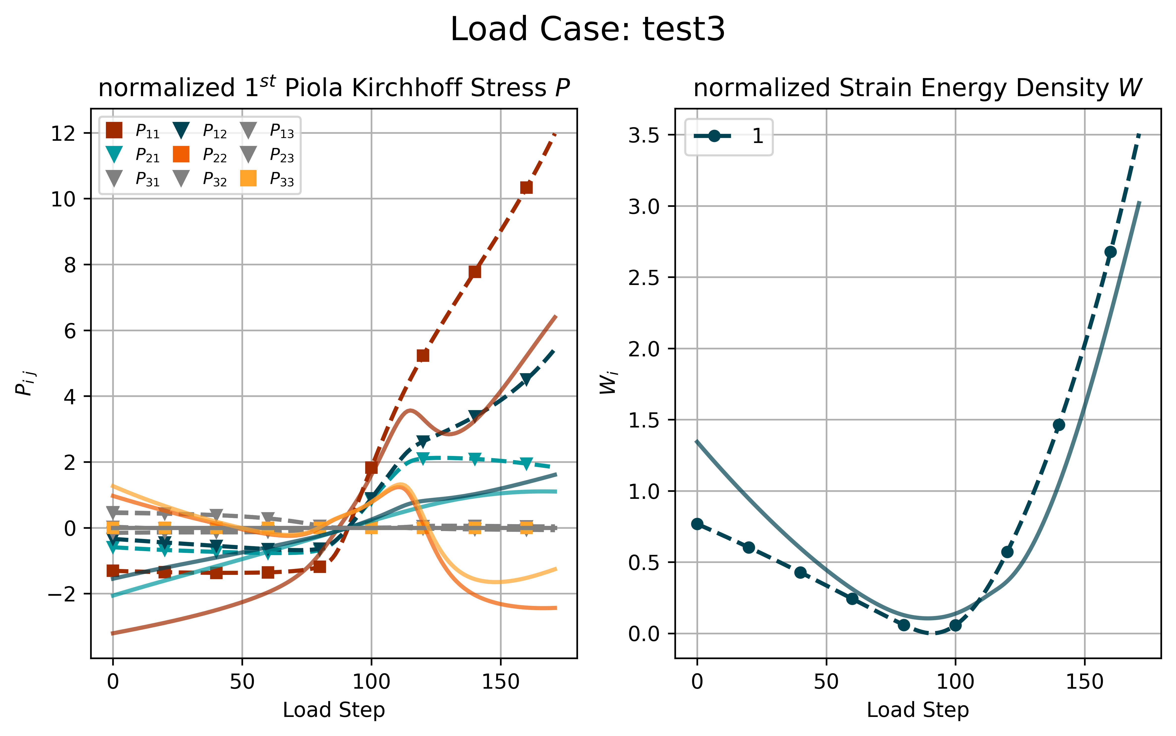
3 – 1.2
Invariant-based model
Notes:
Maybe add weights as a diagram

Slide 35
Tutorial Machine Learning in Solid Mechanics
Discussion

